Slide 1
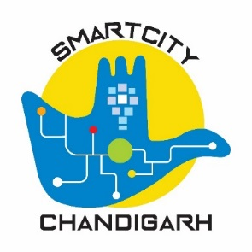
Chandigarh
‘The City Beautiful’
transforming as
‘SMART CITY’

Slide 2
Smart City
Smart City Mission
1
2
Selection of Smart City
Smart City fulfills the aspirations of city residents for his/her comprehensive development and well being by providing for infrastructure and services for Physical, Social, Economic & Infrastructure needs of the city with a vision to create urban ecosystem of Livability, Sustainability, Equality and Innovation”
Smart City Mission, a MoUD programme used ‘Challenge’ or competition’ method to select cities for funding and using a strategy of area-based development. This captures the spirit of ‘Competitive and Cooperative Federalism’.

Slide 3
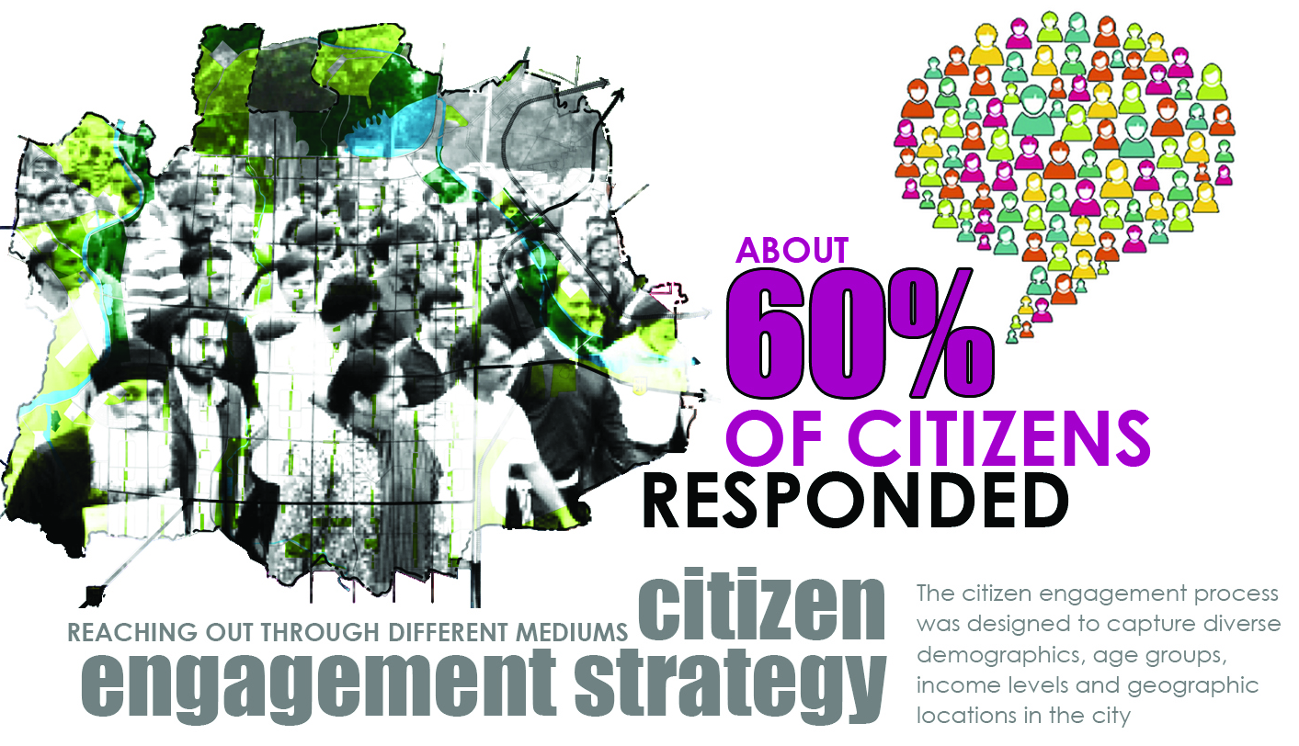
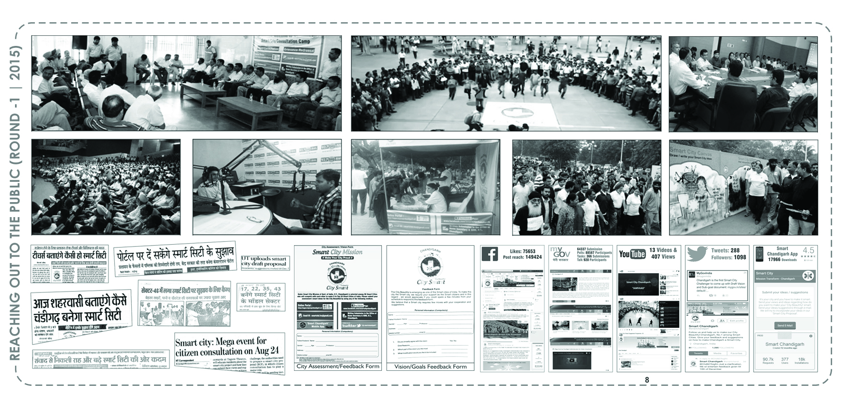
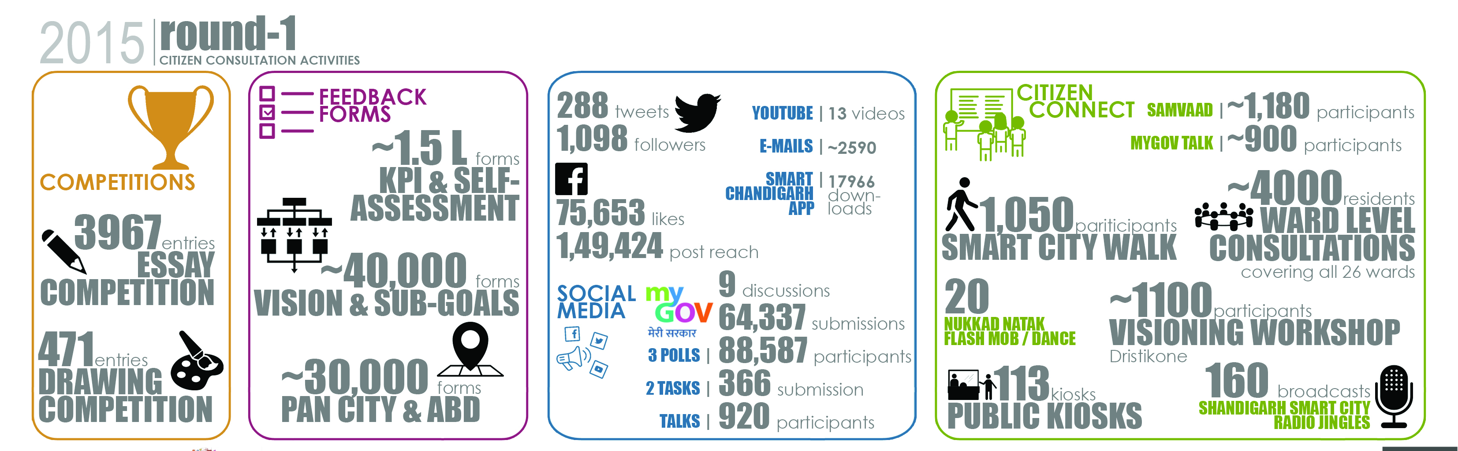
Smart City Mission & Chandigarh

Slide 4
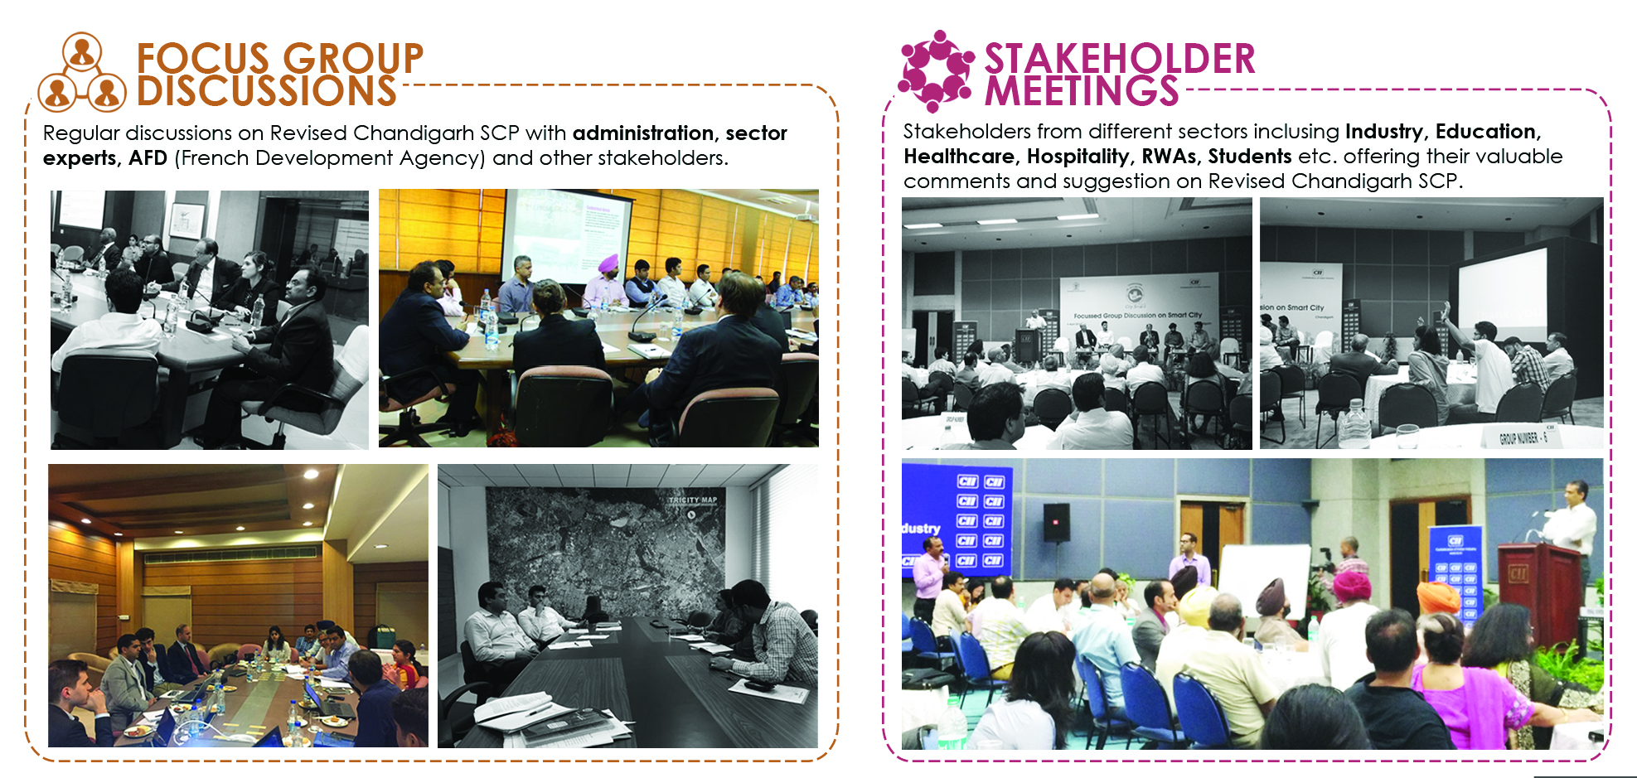
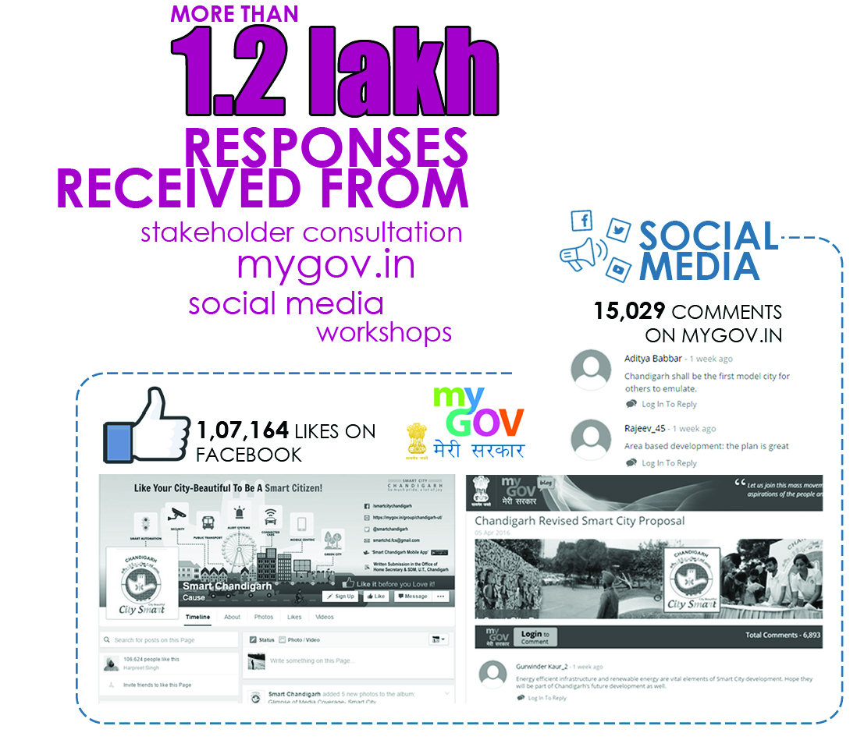
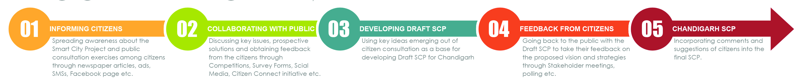
Smart City Mission & Chandigarh
Chandigarh was selected as a Smart City in May 2016

Slide 5
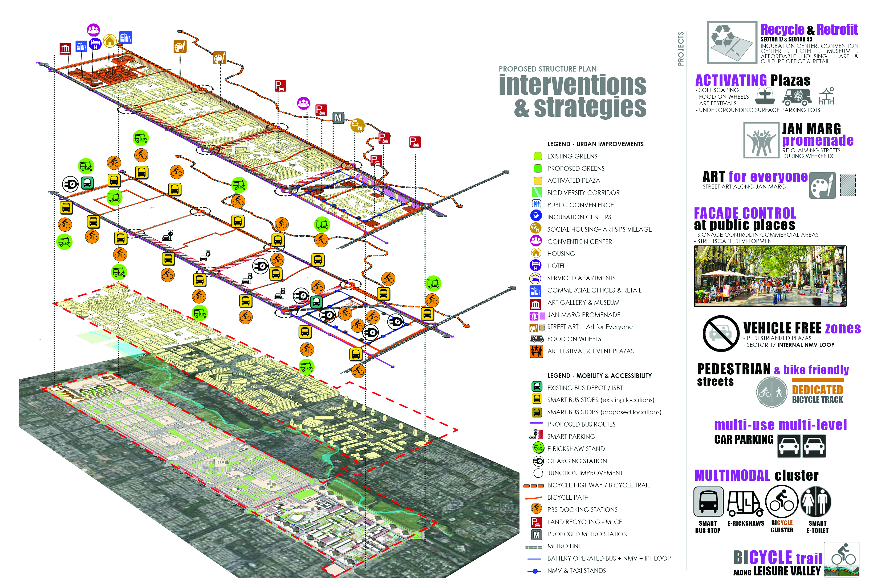
Smart City Mission & Chandigarh

Slide 6
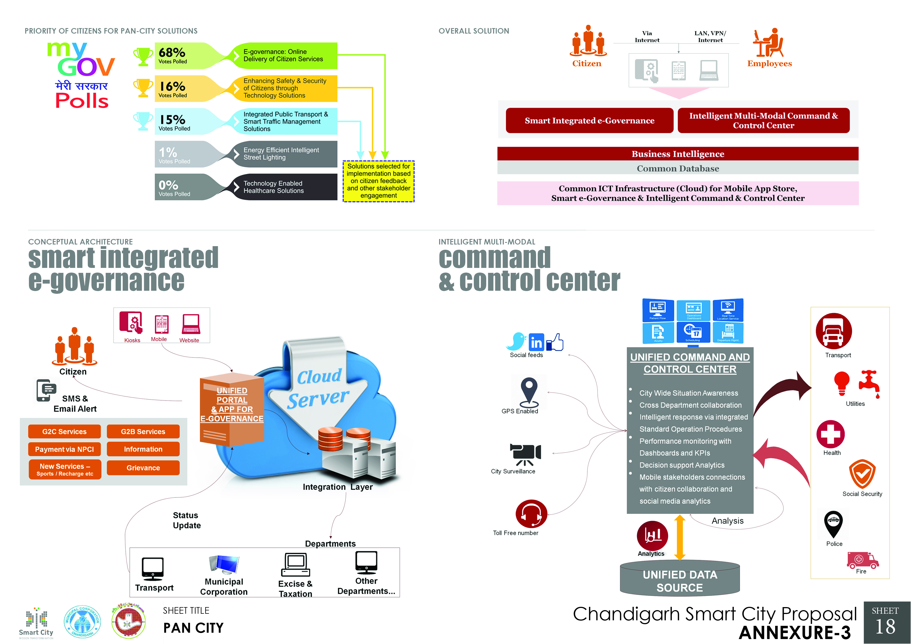
Smart City Mission & Chandigarh

Slide 7
Smart City Mission and Chandigarh
Convergence of Projects
CSCL
Convergence projects are being funded and executed by respective departments - Swachch Bharat Abhiyan, Solar Power, National Smart Grid Mission
SPV (Special Purposed Vehicle) named as CSCL (Chandigarh Smart City Limited) formed in June 2016.
Execution of projects
Design, Implement, Execution & Monitoring of projects
Smart City
4
Chandigarh was selected as a smart city May 2016
2
5
1
3
Consultancy Services
Egis International, a French Engineering Consultancy selected as Project Management Consultant for Chandigarh Smart City Limited.

Slide 8
Governance Structure of CSCL
Chairman CSCL
Administrator (UT)
Chairman, Board of Director
Advisor to Administrator
Principal Secretary (Home).
Finance Secretary.
Commissioner, M.C C.
Ex-Officio, CEO
Deputy Commissioner
Chd.
Under Secretary (HRIDAY)
Chief Engineer UT
Chief Engineer, M.C.C
As Per Organization Chart
Chief Architect UT

Slide 9
Organizational Chart
Chief Executive Officer
Additional Chief Executive Officer
Additional Chief Executive Officer
Chief General Manager
General Manager (Tech & Engg)
General Manager
(Operations)
Company Secretary
Chief Financial Officer
GM (Planning & Design)
Manager ( Engg.)
Manager (Tech.)
Deputy Manager (Legal)
Deputy Manager ( Engg.)
Deputy Manager (Tech.)
Deputy Manager ( F & A)
Manager (Procurement)
Deputy Manager (MIS)
Assistant Manager ( F & A)
Assistant Manager (Procurement)

Slide 10
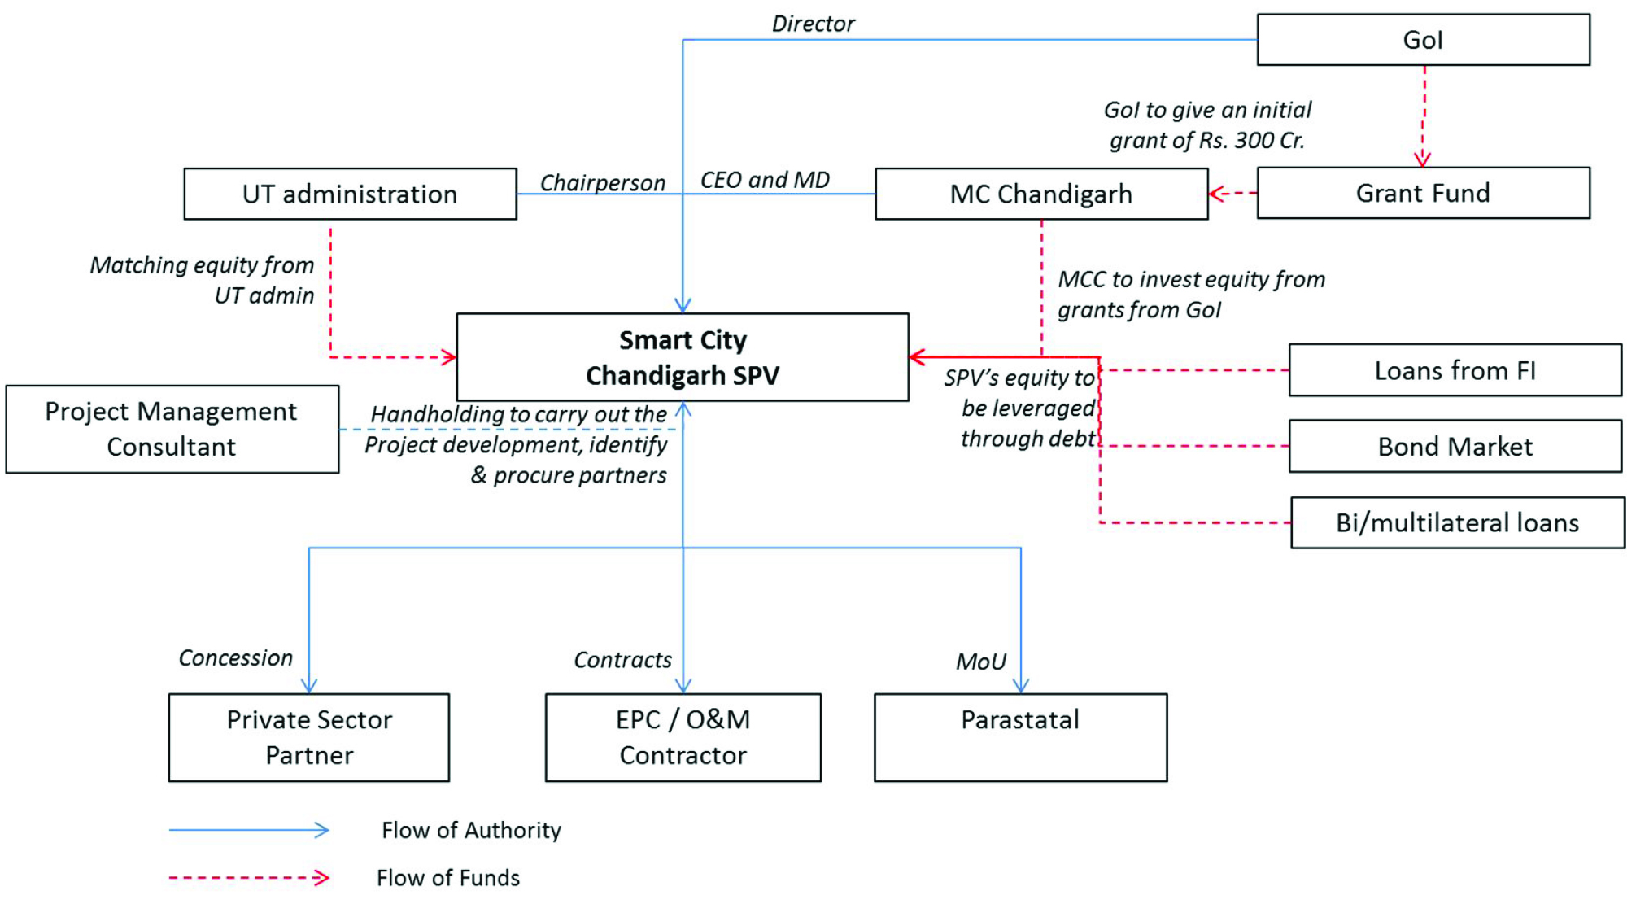
SPV Working

Slide 11
Key Technical Strength- CSCL
1
2
3
5
4
Engineering
Civil & Infrastructure
Urban Planning & Architecture
Public Finance &
Procurement
Legal
&
Contract
Information
& Communication
Technology

Slide 12
Smart City Fellows???
Smart City Fellows
Strategies- Chandigarh
The India Smart Cities Fellow (ISCF) program engages young graduates/post graduates and PhDs in various fields for providing the necessary support to Mission Director, Smart Cities in MoHUA and/or CEOs of selected Smart Cities in terms of analytics, research, documentation, independent assessment, visualization or any other related activities including preparation of reports, posters, dossiers, etc
Chandigarh Live
Social Media
Jal Sanrakshan Hackathon
Media Competition
E-Gov – Beta Version
CSCL Website

Slide 13
NITI AYOG
Smart City Mission and Chandigarh
Advisory Forum
Mission Director Smart City
MoHUA
A consultative forum headed by the Mayor & other elected representatives of Chandigarh Is present to monitor projects.
Mayor, Chandigarh
MP from Chandigarh
6 Councillors of MCC ( 2 each zone)
5 Representatives from RWA’s
3 Representatives from Traders Association
2 Representatives from Industry Association
CEO, CSCL
Data Collation
Progress Monitoring- Short & Long Term
Release of Funds
Review the project wise progress through Management Information System (MIS).
Review through VC’s,

Slide 14


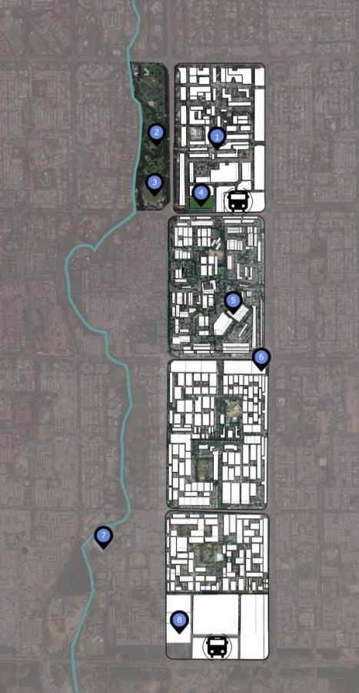
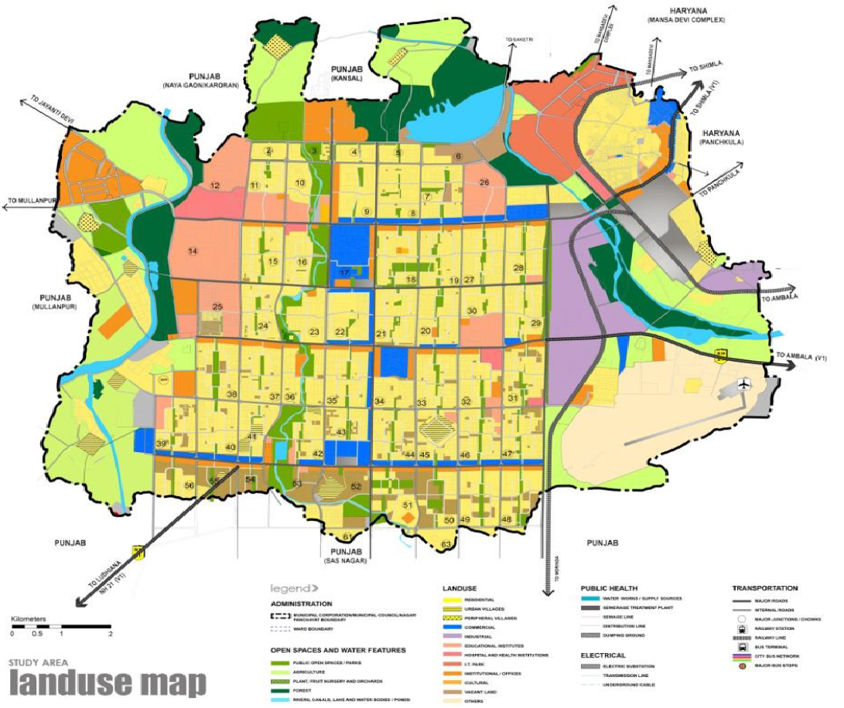
Chandigarh Smart City
Smart way of making City Beautiful
Pan City Projects
Sec 18
6.5 acres
Area – 114 sq.km
Population 2011 – 1054686
Expected Capital Investment –Rs. 1401.6 Cr including convergence and Rs 1166 Cr Through CSCL
119 Acre
Sec 16
Sec 17
293 Acre
269 Acre
Sec 22
Area Based Development
297 Acre
Sec 35
1. Area – 1265 Acres (5.08 sq.km)
2. Expected Type of Development –Retrofitting and infill
3. Expected Capital Investment – Rs. 5271.09 Cr (Total including Convergence) out of which Rs 5189.47 cr is through CSCL
279 Acre
Total Projects in SCP: 60
CSCL : 35
Convergence: 25
Sec 43
Project Period: 36 Months

Slide 15
Chandigarh Smart City
Smart way of making City Beautiful
Pan City Projects
Sec 18
6.5 acres
Area – 114 sq.km
Population 2011 – 1054686
Expected Capital Investment –
Rs. 2098.63 cr including convergence and Rs 1808.81 Cr Through CSCL
119 Acre
Sec 16
293 Acre
269 Acre
Sec 22
Area Based Development
297 Acre
1. Area – 1265 Acres (5.08 sq.km)
2. Expected Type of Development –Retrofitting and infill
3. Expected Capital Investment – Rs. 193.08.Cr ( all through CSCL)
Sec 35
279 Acre
Total Projects in SCP: 60
CSCL : 35
Convergence: 25
Sec 43
Project Period: 36 Months

Slide 16

Vision of CSCL
“The city beautiful is envisioned to become leader in livability, sustainability, equality and innovation”

Slide 17
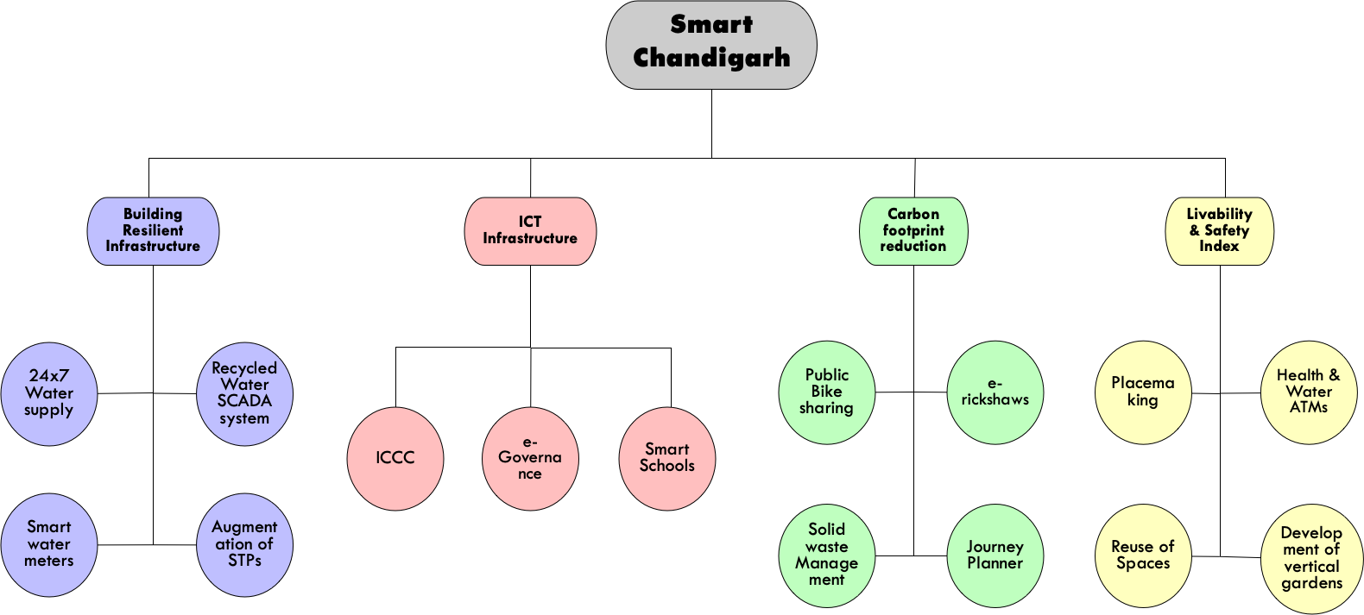
Objectives of CSCL
“The objective is to perform activities necessary to plan, design, integrate, package, administer and manage the development and construction of Area based development (ABD) and PAN city project under Chandigarh Smart City Proposal ”
Monitoring of Street Lights
Sensory Park

Slide 18
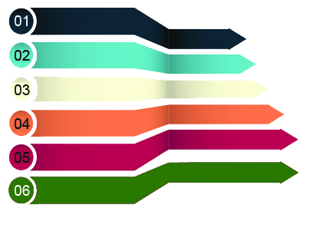
Priority Sectors
Potable Water & Wastewater
Surveys & Investigations
Solid Waste Management
Situation Analysis
Urban Retrofit & Redevelopment
Feasibility
STAGES – PROJECT OUTPUT
DPR
Mobility & Social Sector
RFP/ Tender
Implementation
Energy Reforms
Pan City ICT Projects

Slide 19
Planning & Implementation Process
Area based Development
Project Development
& Design
Project Development
Broad Scope
of Services
Team
Mobilization
Data Collection
& Review
Existing Situation Analysis
Feasibility Study & Design Basis Formulation
Preliminary/ Detailed Project Reports
Tasks
Review and Appraisal of SCP
Synergising & identification of gaps and overlaps
Review existing status
Identify necessary surveys & investigations
Integrating into GIS Platform
Review of available technical options
Identification of viable technical options among the alternatives
Identify project mode
Project development road map
Identifying issues- pertaining to environment, land availability etc.
Developing preliminary or detailed design
Estimates, statutory clearances, mitigation measures etc.
Assistance on technical, commercial, financial & legal aspects
Bid Process Management
Bid document preparation/ invitations
Selection of contractors, negotiations, award of contract, signing of contract.
Transaction advisory and bid process management
Program Management
Development of Program Management Information System
Development of program policies & procedures
Construction Supervision & Contract Management
Project facilitation & implementation
Consultation & technical assistance
Develop technical specifications
Quality control and Inspection
Monitoring & Scrutinizing of detailed work program
Tasks
Post Implementation support
Support during defect liability period, certification & handover of the project

Slide 20
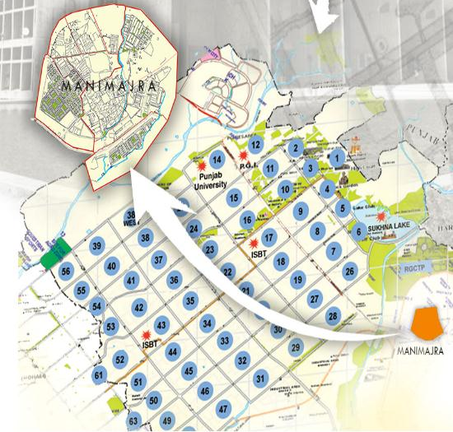
24x7 WATER SUPPLY (MANIMAJRA)
Components
Construction of UGR, OHSR
Installation & Upgradation of Existing Pumping Machinery
Retrofitting of existing Pipeline Network.
Installation and Implementation of SCADA
Smart Metering
Cost
CAPEX: 71.10 CR
OPEX : 91.96 CR.
Total Cost 163.06 Cr.

Slide 21
24x7 WATER SUPPLY (PAN CITY)
Components
Construction of new UGRs for Raw Water and Clear water storage.
Installation & Upgradation of Existing Pumping Machinery to Variable Frequency Derive Pumps (VFDs) for 24x7 Water Supply.
Retrofitting of existing Pipeline Network.
100% AMR Ready water metering at all the consumer ends.
Installation and Implementation of SCADA System
Cost
CAPEX: 440.11 CR
OPEX : 3125.57 CR.
Total Cost 3565.68 Cr.

Slide 22

Bulk & Consumer Metering in Zones
Repair, Replacement/ Upgradation of System
Modifications as per Model to continue 24x7 Supply without Increasing Demand
NRW Management
Operation & Maintenance
Installation of Communication System & SCADA
Leak Detection & Repairs followed by Water Balance
Conducting Water Balance
Study of System i.e. Level, Pressure, Flow , etc.
Creation of Zones w.r.t. DMAs
OHSRs & UGR
Objectives
Ensure safe and equitable water supply around the clock (24x7) to all households
Reduce the overall consumption of water by reducing water losses as well as NRW,
Ensuring to bring about 100% recovery of water charges,
Improve and augment the economic and social infrastructure,
Making sure the technical and economical sustainability of the water supply service.
Process Flow

Slide 23



e-Governance in Chandigarh
Citizen Related –Services dealing with citizens
at present operating manually.
Internal Services –Services of MC Chandigarh
helping with day to day working

Slide 24














Booking of Banquet Hall / Community Hall
E-Horticulture Services
E-Challan
Open Space Building Material
Estate Management
Fire services
Trade and marketing license
Online Permission Management (NOC and Permissions)
Integration With Birth And Death
Online Grievance Compliant Services
Water Supply and Sewerage Connections
Integration with Property Tax Management
Rented Properties under Colony Branch and Estate Office
National Urban Livelihoods Mission
Citizen Services

Slide 25













Store Management
Legal
Sports & Cultural Department
Apni Mandi And Day Market
Financial Accounting
Integration With RTI
DAK
Integration With E-Awas
AUDIT
Agenda Branch
HR And Payroll
Public Relation Department
Work management
system
Back Office / Internal services

Slide 26
e-Governance in Chandigarh
02
04
06
Applicant will select the required service & will fill form
Applicant will submit the form & submit Payment online/offline
Alert citizen via SMS/EMAIL/Notification at each level of approval
Final Alert
01
02
03
04
05
06
07
“Your service with application number 123xx have been processed successfully, in case service/ issue is not resolved please escalate the issue at” form link will open where applicant will submit his/her feedback/remarks and it will be submitted to appellate authority mentioned as per citizen charter and service/application status will be updated from closed to open.
01
03
05
07
Cost
Applicant will open the CSCL web portal or Mobile app
Upload documents as per service requested
Alert via SMS/EMAIL/Notification
Information about
    Unique application number
    Date of submission
    Turn around time as per citizen charter
Options to escalate the matter to appellate authority
Automatically escalated to appellate authority if services/issue not provided as per citizen charter time line.
Total Cost: 11.49Cr.
Process flow for Citizens/Applicants

Slide 27

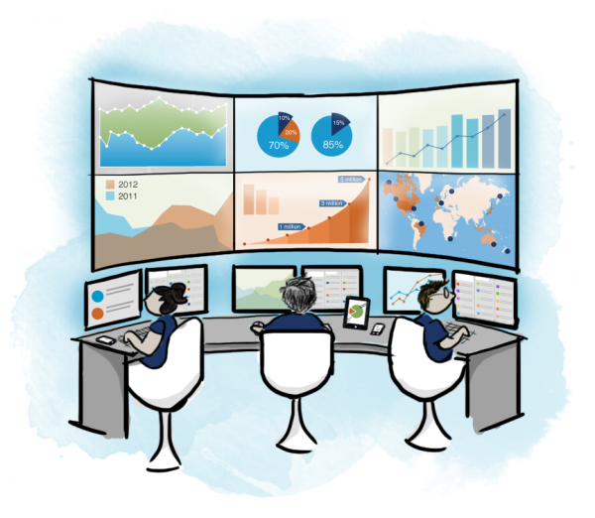


Integrated Command & Control Center (ICCC)
Brain of the city!
Impact
Centralised monitoring, control and command of the city.
Crisis and disaster management.
Aggregation of city information under one umbrella.
Fast, efficient and effective decision making.

Slide 28
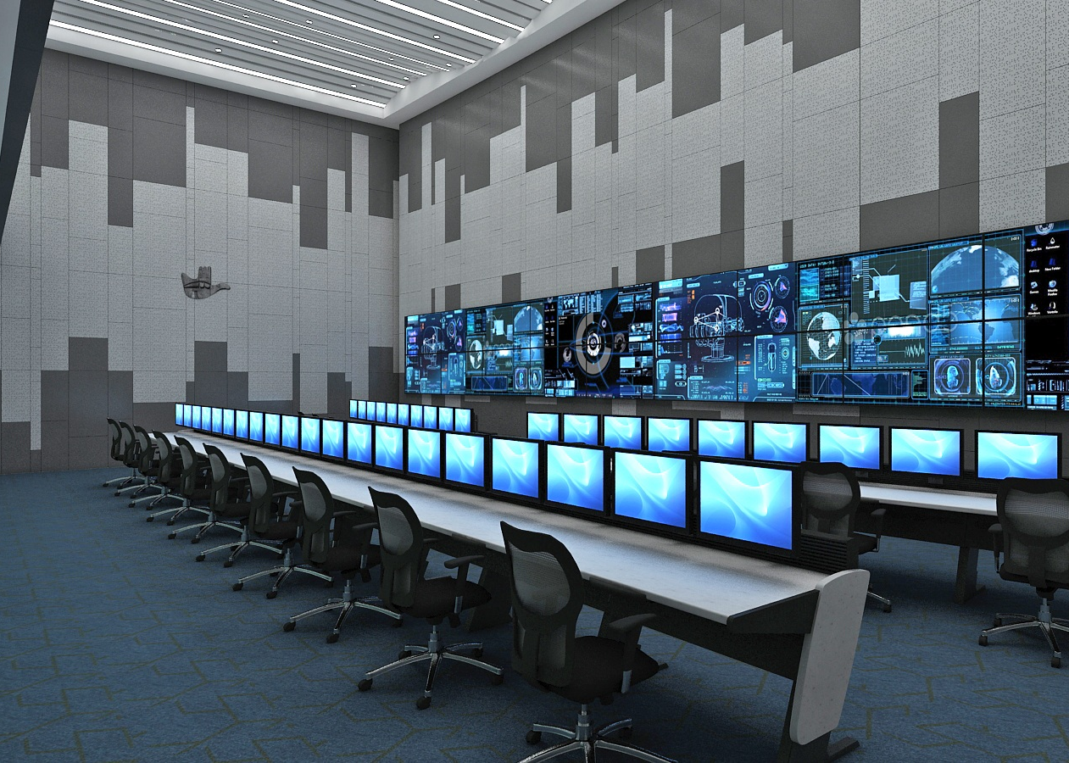
Project to be Integrated
Utility management (SCADA)
Municipal Solid Waste Management
Smart Lighting (LED)
Smart Parking
Public Bike sharing
Intelligent Transport system (CTU)
Intermediate Public Transport

Slide 29
ICT PAN CITY – ICCC
Projects to be Implemented | Project to be Integrated
Integrated Command And Control Centre | Utility management (SCADA)
Intelligent Traffic Management System | Municipal Solid Waste Management
E-Governance (MCC services) | Smart Lighting (LED)
Adaptive Traffic control System | Smart Parking
Dynamic Message Signs | Public Bike sharing
GIS With Analytics | Intelligent Transport system (CTU)
City Network (Optical Fiber Cable) | Intermediate Public Transport
City Surveillance | Chandigarh Smart City Card
 | Citizen Services of UT Admin (E Sampark) Environment sensors
Cost
Total Cost: 228 Cr approx.

Slide 30
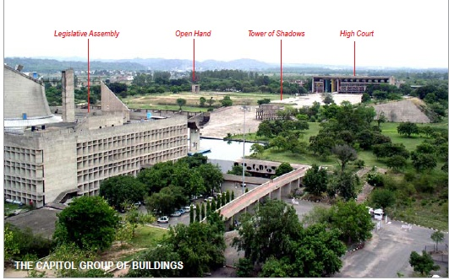
Capitol Complex
World Heritage Site- Restoration

Slide 31
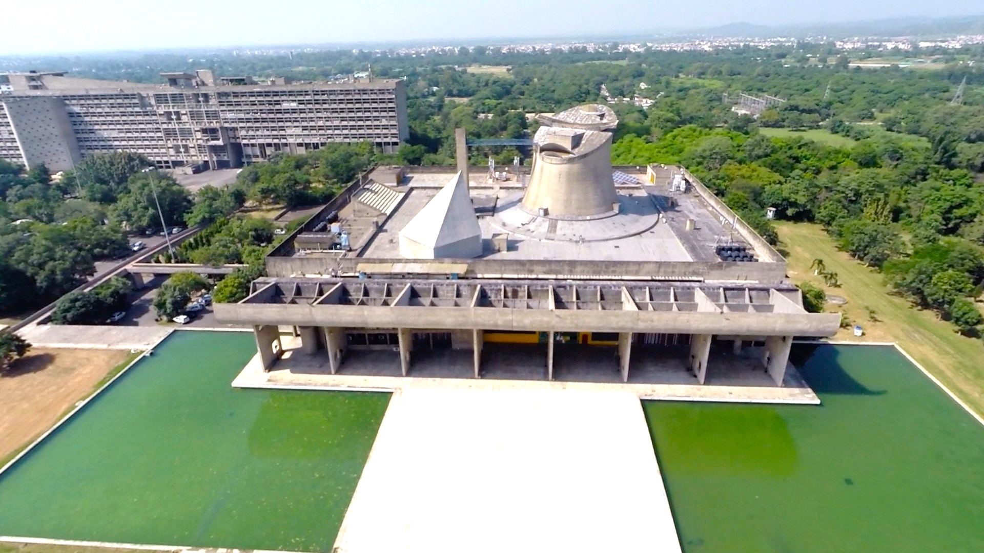
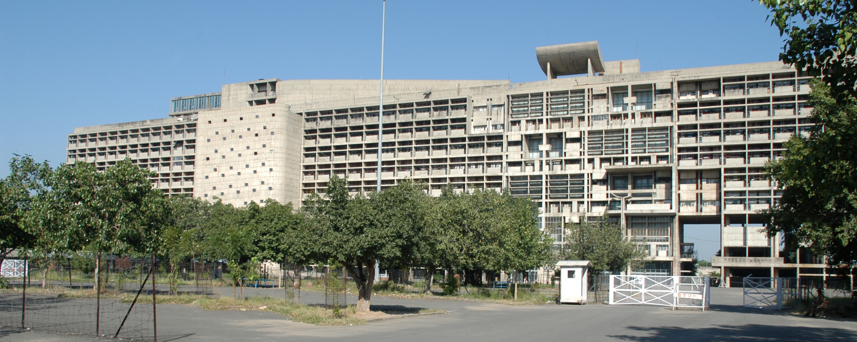
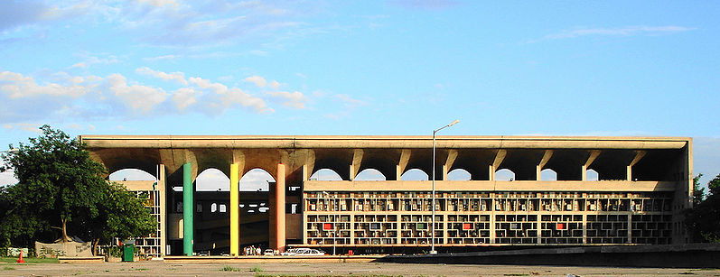
Capitol Complex
World Heritage Site- Restoration
The Assembly, the High Courts and the Secretariat buildings celebrating the three pillars of democracy-
the Legislature, the Judiciary and the Executive respectively are skilfully and holistically integrated through the vast pedestrian plaza

Slide 32
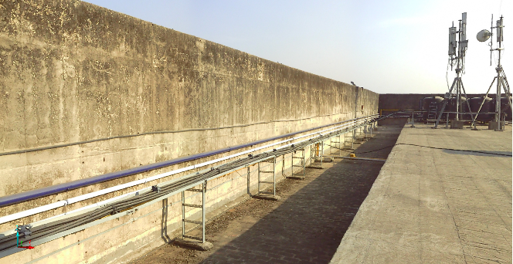
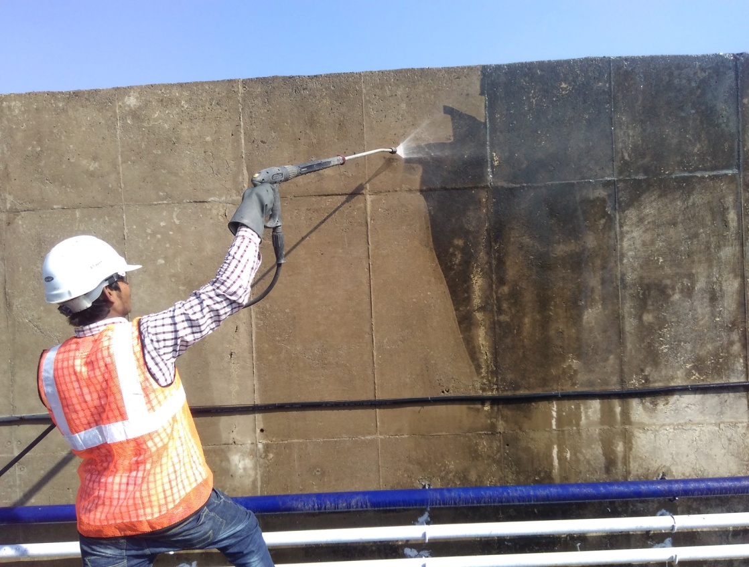
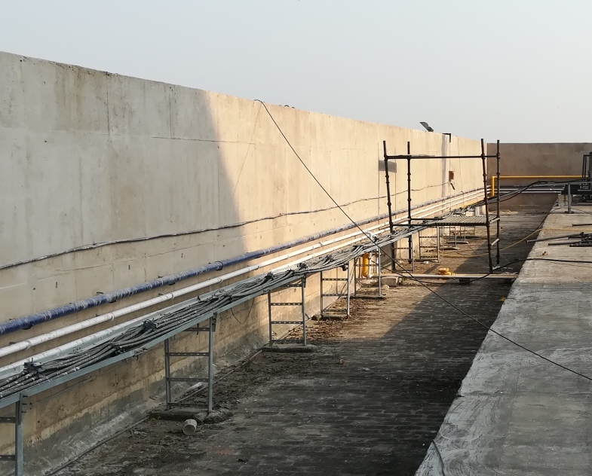
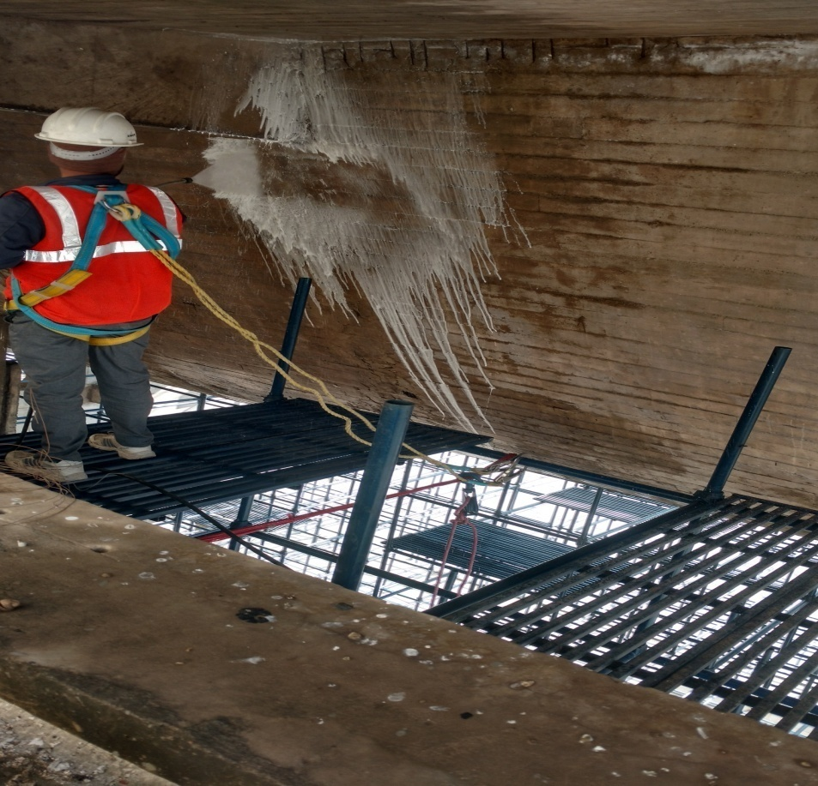
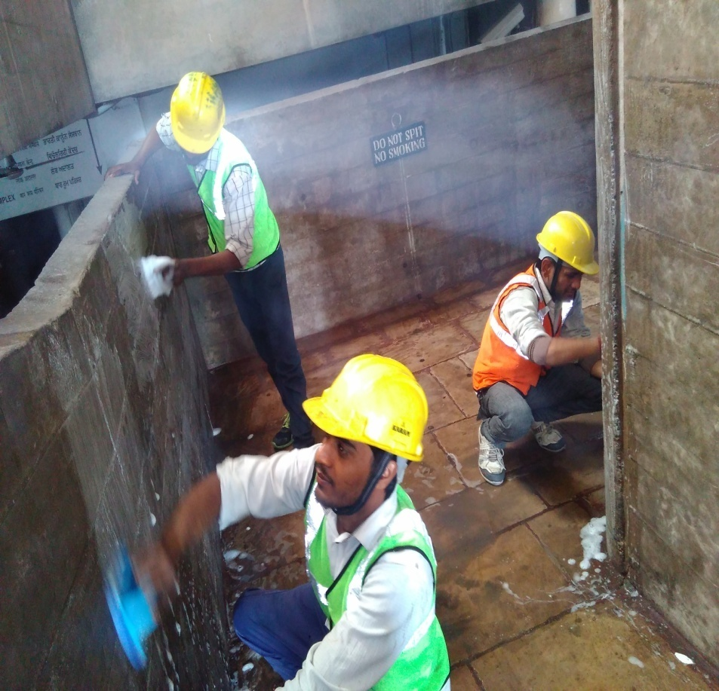
Capitol Complex
Before
During
After
Restoration of Heritage Projects
WITH NANO CHEMICALS
STAIN REMOVING

Slide 33
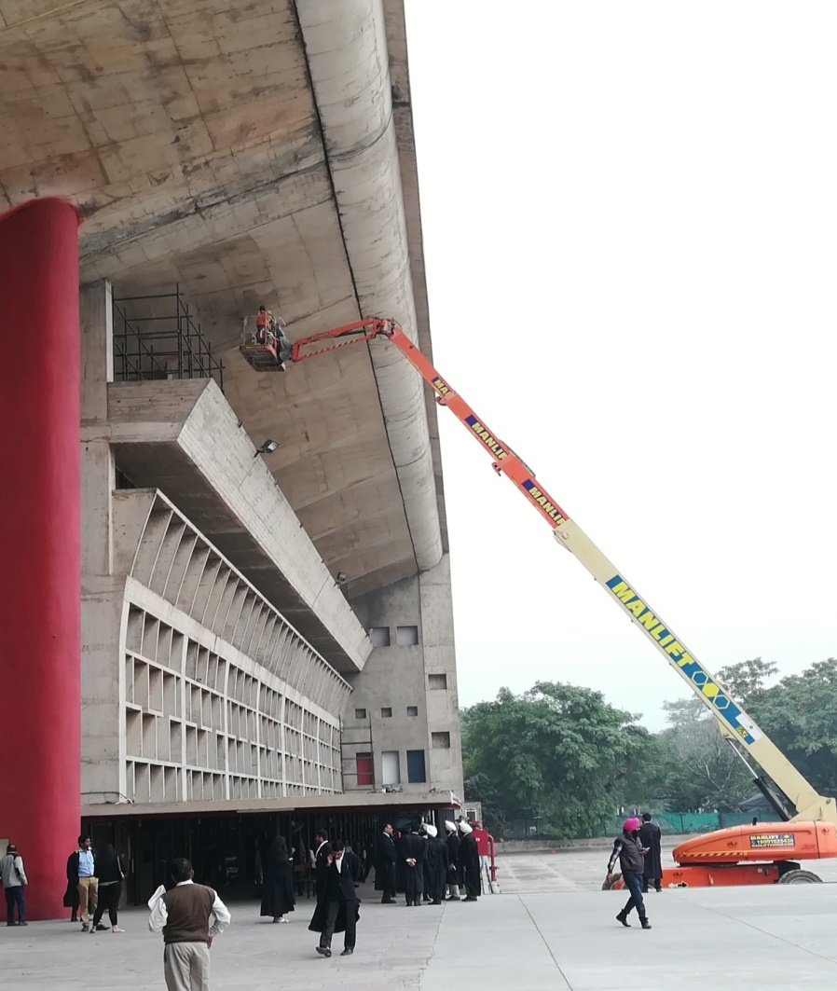
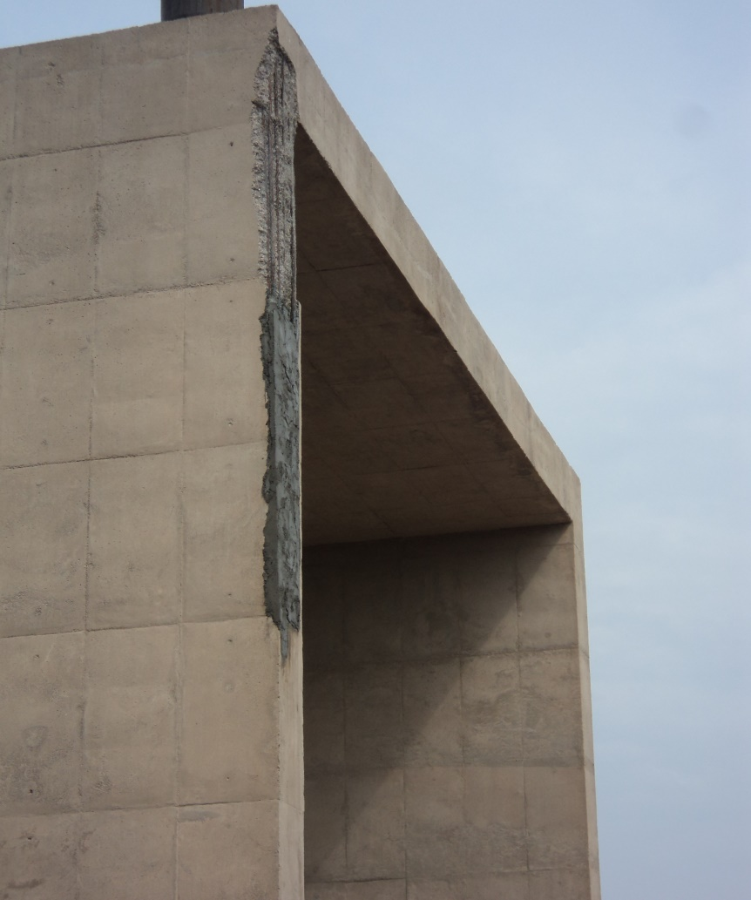
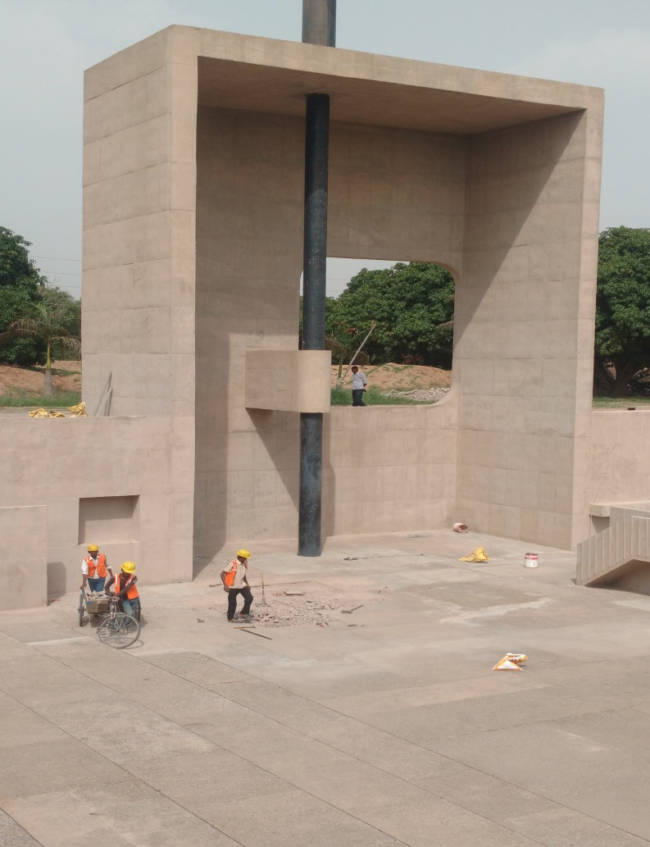
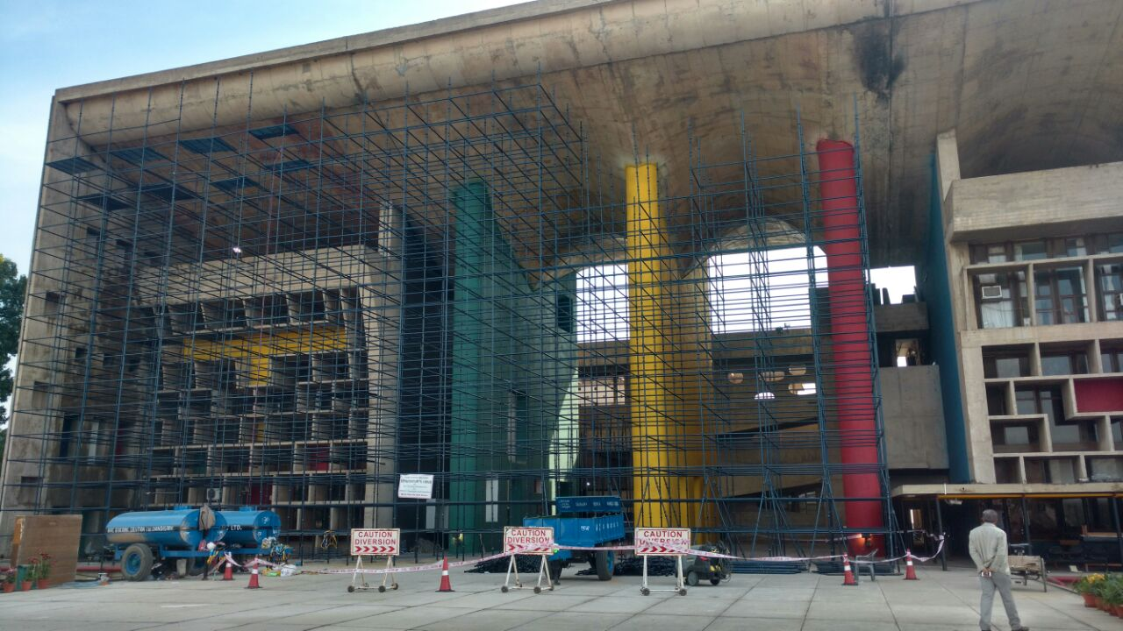
Capitol Complex
Before
After
Before
After
HIGH COURT
OPEN HAND

Slide 34
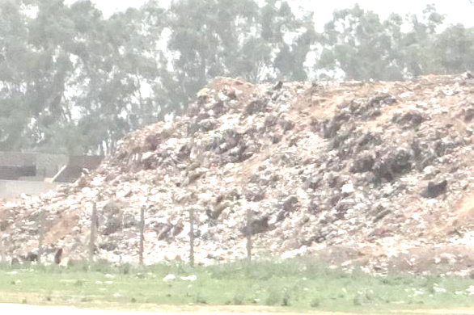
Legacy Waste Mining at Daddu Majra Dumping Site
Cleaning of 5 Lakh MT of Dump proposed over next 18 months Through Bio remediation
Impact
Environmental friendly Recycle and Reuse of waste as RDF and Soil Enricher of 5 Lakh MT of Waste
Omission of public nuisance
Reclamation of 16 Acres of Urban Land
Reduction in Foul Odour for near by Colonies
Cost
Total Cost 33.98 Cr.

Slide 35
Project Scope
Legacy Waste Mining at Daddu Majra Dumping Site
Dispose off around 5,00,000 MT existing legacy waste from Daddu Majra Dumping Ground (DMDG) through scientific mining and processing by way of deploying suitable & adequate number of heavy earth moving machinery, processing equipment, transportation of segregated material and scientific treatment technology.
Minimize the nuisance to the residents of Daddumajra on account of the fugitive emission, spontaneous combustion, Leachate etc.
Reclaim the entire 25 acres land blocked with the dump for future use.

Slide 36
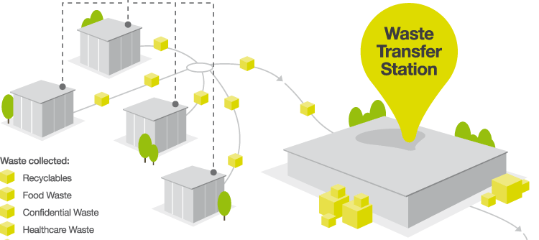
Garbage Transfer Station cum Material Recovery Facility
Cost
Total Cost 31.83 Cr.
Total 3 no. MRF-cum GTS proposed
Segregated wet and dry waste processing
Material recovery platform for segregation of reusable materials
Dry waste end product carried to RDF plant
Wet waste end product carried to Compost plant

Slide 37
Augmentation of Sewerage Treatment Plants (STPs)
Impact
S. No | Location | Capacity (MGD) |  | Technology |  | Remarks
 |  | Existing | Proposed | Existing | Proposed
1 | STP at Diggian | 30 | 30 | MBBR | Open Technology to meet the functional guarantees & desired parameter | New plant(s) will be constructed
2 | STP at Raipur Kalan | 5 | 5 | UASB
3 | STP at Raipur Khurd | 1.25 | 2 | ASP
4 | STP at Kishangarh | - | 0.44 | -
5 | STP at 3 BRD | 11 | 11 | SBR | - | Additional units to be added
6 | STP at Dhanas | 1.65 | 1.65 | SBR | -
7 | STP at Raipur Kalan | 1.25 | 1.25 | SBR | - | Not Commissioned
8 | STP at Maloya | 5 | 5 | SBR | - | Under Stabilization
Total (MGD) |  | 55.15 | 56.34
Efficient processing of waste water to make it fit for reuse
BOD <= 5mg/litre
  Improve Effluent Standards
Ageing Equipment and Technology
Expansion of Treatment Capacity
More Energy Efficient.
Reduces risk to public health and the environment
Cost
Total Cost: 555.77 Cr.

Slide 38
INSTITUTIONAL SETUP
Municipal Corporation Chandigarh
ADMINSTRATIVE HEAD COMMISSIONER
CHIEF ENGINEER
ADDITIONAL COMMISSIONERS (3)
SPECIAL COMMISSIONER
SE -B&R
SE-PH
1. Establishment
2.Tax Branch
3.Legal cell
4.Estate Br.
5.Building Br./Planning cell
6.Col.& license Br
7. Street vending act
8.Agenda Br.
9.I.T
10. Development cell (AMRUT,SBM,JNNURM,NULM,Primary Education,SJSRY)
11. Sub Office Manimajra
Fire and Emergency Services
1. MOH
2. Primary Health
3. APRO
4.Booking Centre
5. Advertisement and control cell
6. Accounts and House Allotment
7.SDE Mech.
1. Smart City
2. Sports and cultural
3. Parking
4. Enforcement
5.Apni Mandi & Day Market
6.Grievance/Pending reference
Roads
Buildings
Water Supply
Sewerage
Storm Water
TT Water

Slide 39
REVENUES
Municipal Corporation Chandigarh
Description | Estimate ( in Cr)
Capital Grant | 453.30
Revenue Grant | 570.70
Income Generated | 276.86
Total | 1300.86
Description | Estimate ( in Cr)
Capital Expenditure | 476.90
Operational Expenditure | 794.41
Total | 1271.31
Description | Estimate ( in Cr)
Estate | 15.00
Water Tariff & Sewerage Cess | 100.00
Property Tax (Commercial) | 40.00
Property Tax (Residential) | 12.00
Others | 109.86
Total | 276.86

Slide 40
THANK YOU

