Slide 1
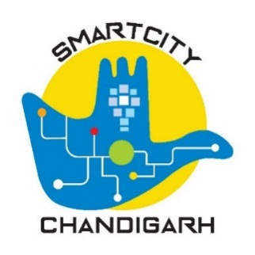
CHANDIGARH SMART CITY LIMITED

Slide 2
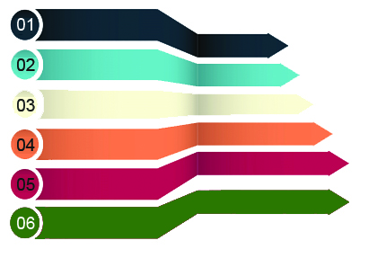
MISSION OVERVIEW
SECTOR
Potable Water & Wastewater
Methodology
Rs. 1486.58 Cr
Solid Waste Management
Surveys & Investigations
Rs. 147.48 Cr
Situation Analysis
Urban Retrofit & Redevelopment
Rs. 27.02 Cr
Feasibility
STAGES – PROJECT OUTPUT
Rs. 120.04 Cr
DPR
Mobility & Social Sector
Rs. 149.91 Cr
RFP/ Tender
Energy Reforms
Implementation
Rs. 261.42 Cr
Pan City ICT Projects
Total Projects
SCP: 63
CSCL : 36
Convergence: 27
Pan City Projects
Area Based Development
Expected Capital Investment – Rs. 1910.52 Cr
Expected Capital Investment – Rs. 282.29 Cr

Slide 3
PROJECT STATUS -CSCL
7
9
16
Rs. 39.6 Cr
Rs. 677.8 Cr
Rs. 1151.33 Cr
12
19
Rs. 120.13 Cr
Rs. 203.95 Cr
2192.81 Cr
63
Notes:
Projects

Slide 4
PROJECT STATUS -CSCL
Work Completed
Tender Issued
Work Order Issued
DPR Approved
DPR under Preparation

Slide 5
Augmentation of Sewerage Treatment Plants (STPs)
Features
100% treatment of Sewage
Most stringent parameters being followed for treatment
Processed Water fit for reuse
BOD <= 5mg/litre
More Energy Efficient.
Risk to public health & env.
Total Project Cost: 855 Cr.
Total Tender Cost: 556 Cr.
Stage: Tender to be reissued after splitting it in 3 packages
Reissue of tender: 15 Feb
Award of Project:15 May
S. No | Location | Capacity (MGD) |  | Technology |  | Remarks
 |  | Existing | Proposed | Existing | Proposed
1 | Diggian | 30 | 30 | MBBR | Open Technology to meet the functional guarantees & desired parameter | New plant(s) will be constructed
2 | Raipur Kalan | 5 | 5 | UASB
3 | Raipur Khurd | 1.25 | 2 | ASP
4 | 3 BRD | 11 | 11 | SBR | - | Additional units to be added
5 | Dhanas | 1.65 | 1.65 | SBR | -
6 | Raipur Kalan* | 1.25 | 1.25 | SBR | - | Not Commissioned
7 | STP at Maloya* | 5 | 5 | SBR | - | Commissioned
Total (MGD) |  | 55.15 | 55.9
*New STPs Constructed by Municipal Corporation

Slide 6
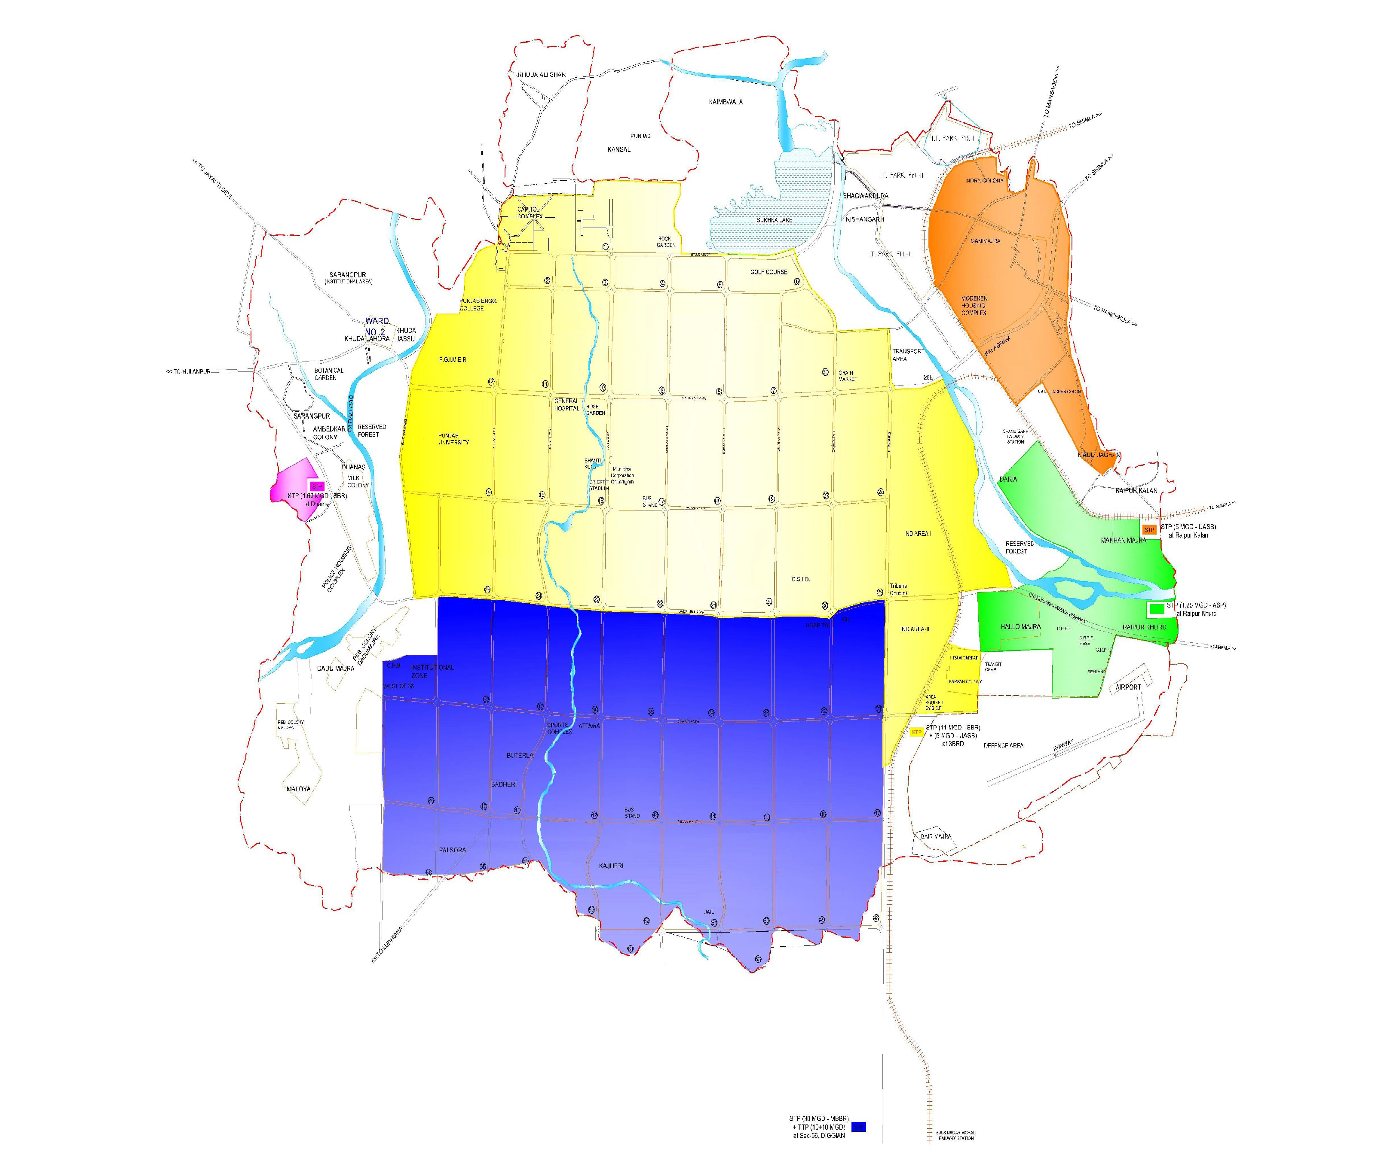
Augmentation of Sewerage Treatment Plants (STPs)
3 BRD STP
Diggian STP
Raipur Kalan STP
Raipur Khurd STP
Dhanas STP

Slide 7
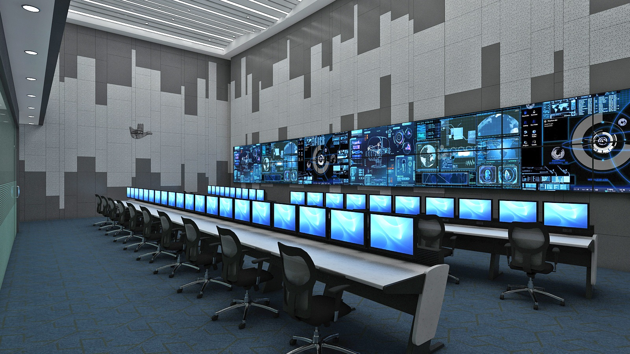
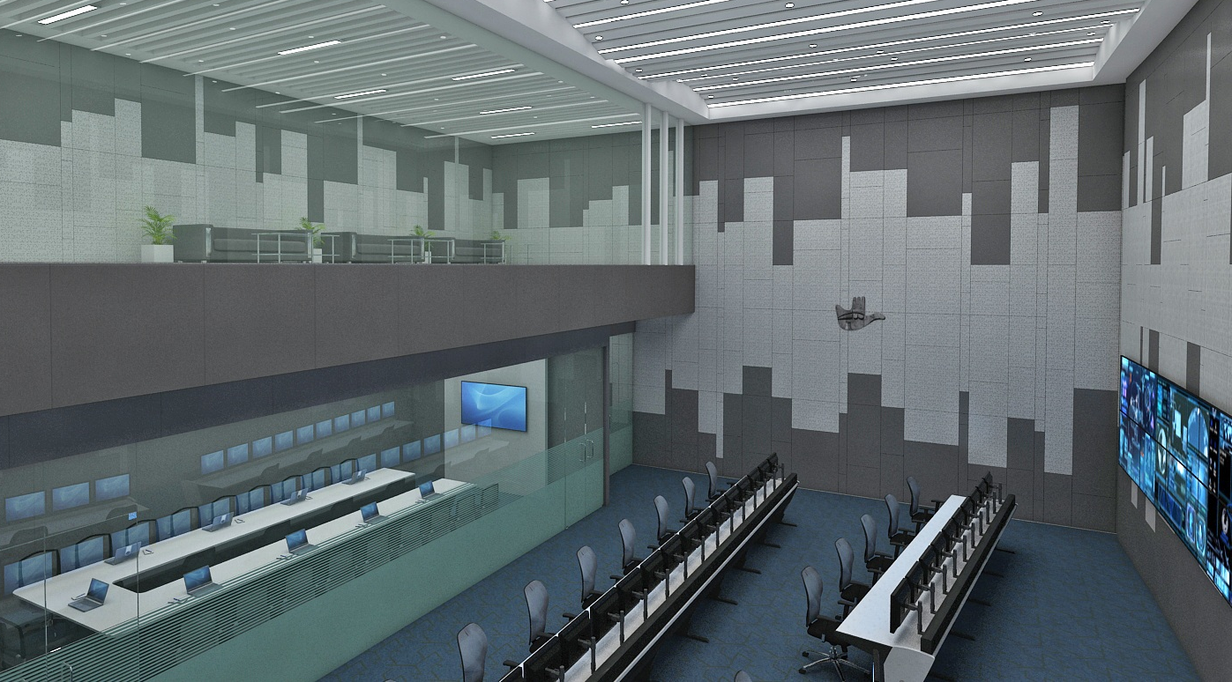
Integrated Command Control Centre
Work Progress Financial Proposal and Draft Agreement from BEL expected today Cost of Project: Rs 239 Cr Signing of Agreement by Jan 2020 Project Implementation Timeline – January 2021
GIS
Assets Mgmt
CCTV
Dynamic
Messaging
Signs
City Network
ICCC
ITS
Traffic Enforcement
Traffic Signals
Monitoring
City Traffic Surveillance
MCC Mobile App

Slide 8
e-Governance Project
Select Services
Citizen Related –Services dealing with citizens
at present operating manually (14 services).
Internal Services –Services of MC Chandigarh helping with day to day working (14 services).
Booking of Banquet Hall / Community Hall
Fire services
Trade and marketing license
Store Management
Phase I -Web Portal & Mobile app, live by Jan’ 20
Phase II- Citizen related services including OBPS, live by Mar’ 20
Phase III- All Internal services, live by June 2020
Financial Accounting
AUDIT
Project Cost: 11.5 Cr.
Stage: Work in Progress
Legal

Slide 9
24x7 WATER SUPPLY (MANIMAJRA)
Components
Particulars | Project Details
Name of the Project | 24 x 7 Water Supply Manimajra- Pilot Project
Scope of Work | Project Area- 855.26 acres Capacity of UGR= 4 MG Capacity of OHSR= 1.29 MG Water requirement – 8MGD Length of Pipeline= 20 KM (Approx)
Proposed Components | Construction of UGR, OHSR Installation & Upgradation of Existing Pumping Machinery Laying of Pipeline Installation and Implementation of SCADA Installation of Smart meter
Proposed Mode | Design Built Operate
Construction of UGR, OHSR
Installation & Upgradation of Existing Pumping Machinery
Retrofitting of existing Pipeline Network.
Installation and Implementation of SCADA
Smart Metering
CAPEX: 71.10 CR
OPEX : 91.96 CR.(15 years)
Total Cost 163.06 Cr.
Tender to Be reissued
Target date of Tender: 28/02/2020
Target date of Award: 01/06/2020
Notes:
Ensure safe and equitable water supply around the clock (24x7) to all households in Manimajra,
Reduce the overall consumption of water by reducing water losses as well as NRW,
Ensuring to bring about 100% recovery of water charges,
Improve and augment the economic and social infrastructure,
Making sure the technical and economical sustainability of the water supply service.

Slide 10
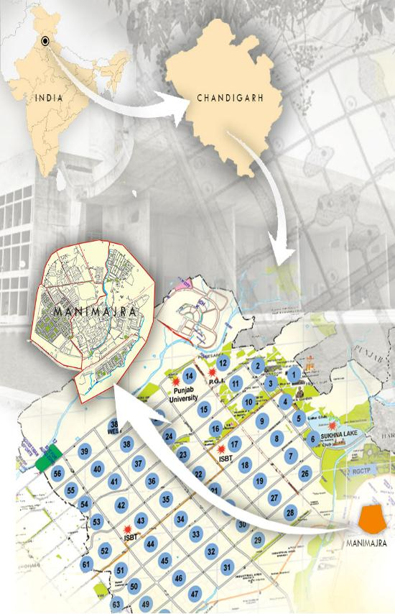
24x7 WATER SUPPLY (PILOT)
Project Area- 855.26 acres
Capacity of UGR= 4 MG
Capacity of OHSR= 1.29 MG
Water requirement of Area – 8MGD
20 km pipeline being replaced
Components
MANIMAJRA
Construction of UGR, OHSR
Installation & Upgradation of Existing Pumping Machinery
Retrofitting of existing Pipeline Network.
Installation and Implementation of SCADA
Smart Metering
CAPEX: 71Cr
OPEX : 92 Cr.(15 years)
Total Cost 163 Cr.
Tender reissued date : 28/02/2020
Target date of Award: 01/06/2020

Slide 11
24x7 WATER SUPPLY (PAN CITY)
Components
Construction of new UGRs
Upgradation of Existing Pumping Machinery to Variable Frequency Derive Pumps (VFDs).
Retrofitting of existing Pipeline Network.
100% AMR Ready water metering
Installation of SCADA System
Effective DEMAND -SUPPLY MANAGEMENT
Leak detection services, UfW reduction to <15%
CAPEX: Rs 440 Cr (Loan : ~Rs 360 Cr)
OPEX : 3125.57 CR.
Funding being sought from AfD
DPR approved by Board
To be sent to DEA for approval
Loan approval Expected by December 2020

Slide 12
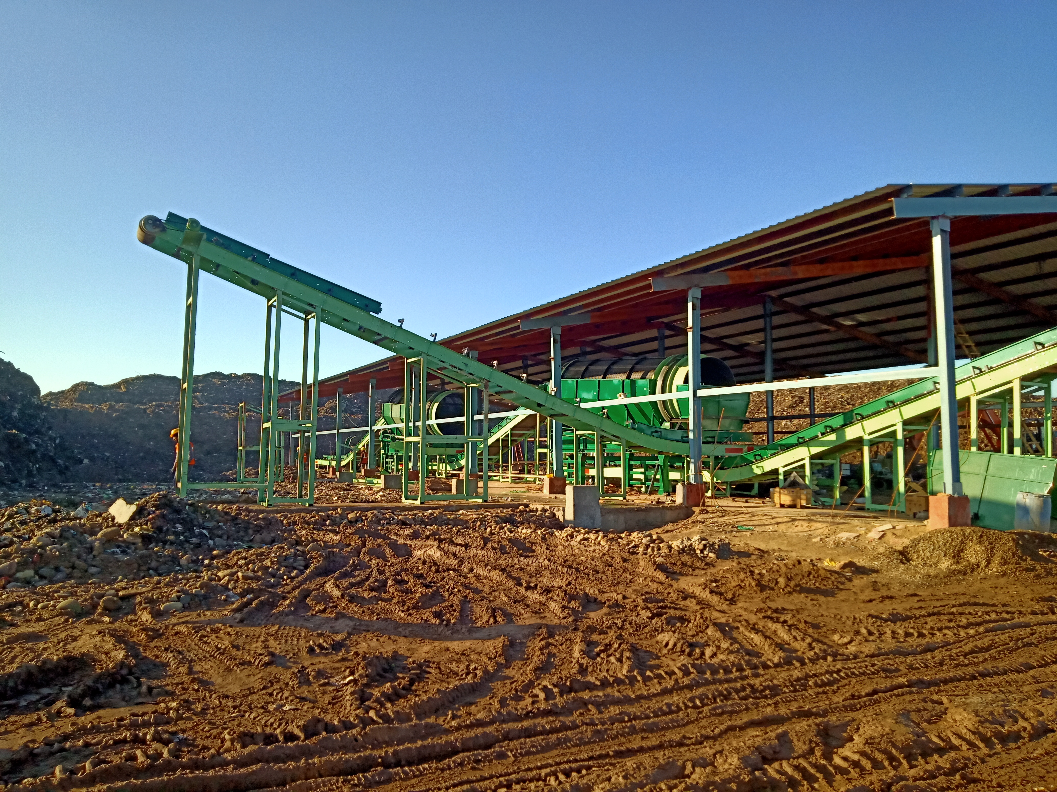
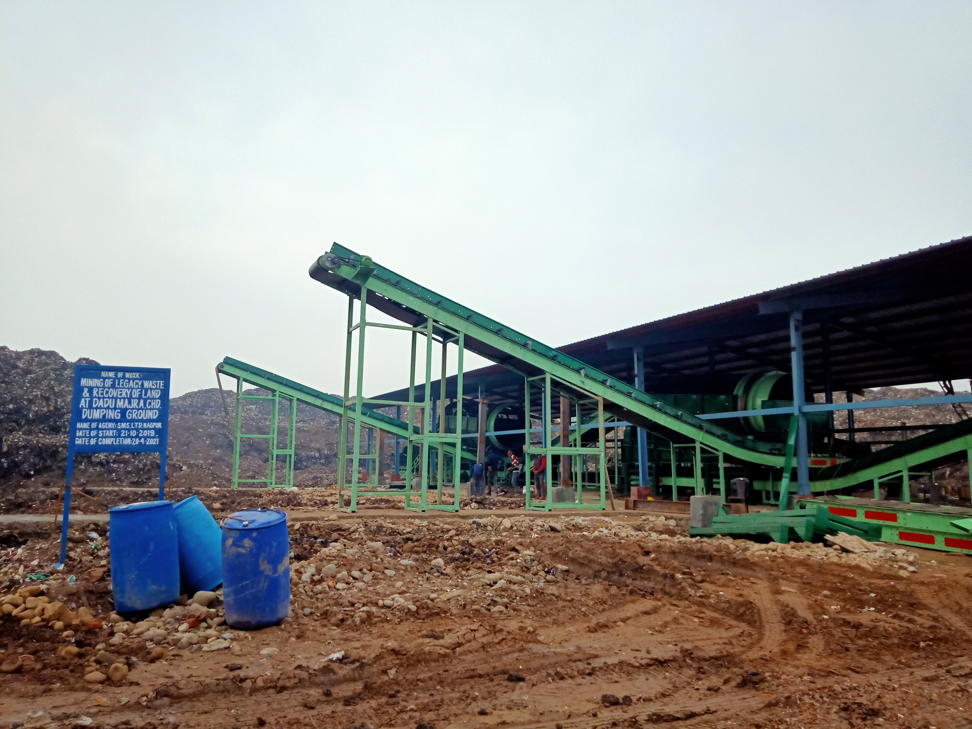
Legacy Waste Mining at Daddu Majra Dumping Site
PROJECT COMPONENT
Cleaning of 5 Lakh MT of Dump proposed over next 18 months Through Waste Mining of 1200 Tonne/day
Impact
Removal of public nuisance
Reclamation of 16 Acres of Urban Land
Reduction in Foul Odour for nearby Colonies
Total Cost 33.98
Status : Under Implementation
Time period : 540 days
Expected date of completion: March 2021
Notes:
Dispose off around 5,00,000 MT existing legacy waste from Daddu Majra Dumping Ground (DMDG) through scientific mining and processing by way of deploying suitable & adequate number of heavy earth moving machinery, processing equipment, transportation of segregated material and scientific treatment technology.
Minimize the nuisance to the residents of Daddumajra on account of the fugitive emission, spontaneous combustion, Leachate etc.
Reclaim the entire 25 acres land blocked with the dump for future use.
Methodology
Excavation of Legacy waste from the dumping ground.
Weighment, transportation and stacking of this waste into Windrows.
Spraying Bio-culture and turning of waste in Windrows.
Shifting of 7 day old waste from Windrows to processing unit lines.
Treatment and Segregation of ingredients of waste and collection of end product.
Disposal of segregated end product

Slide 13
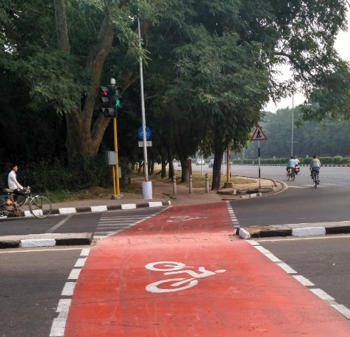
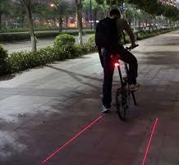
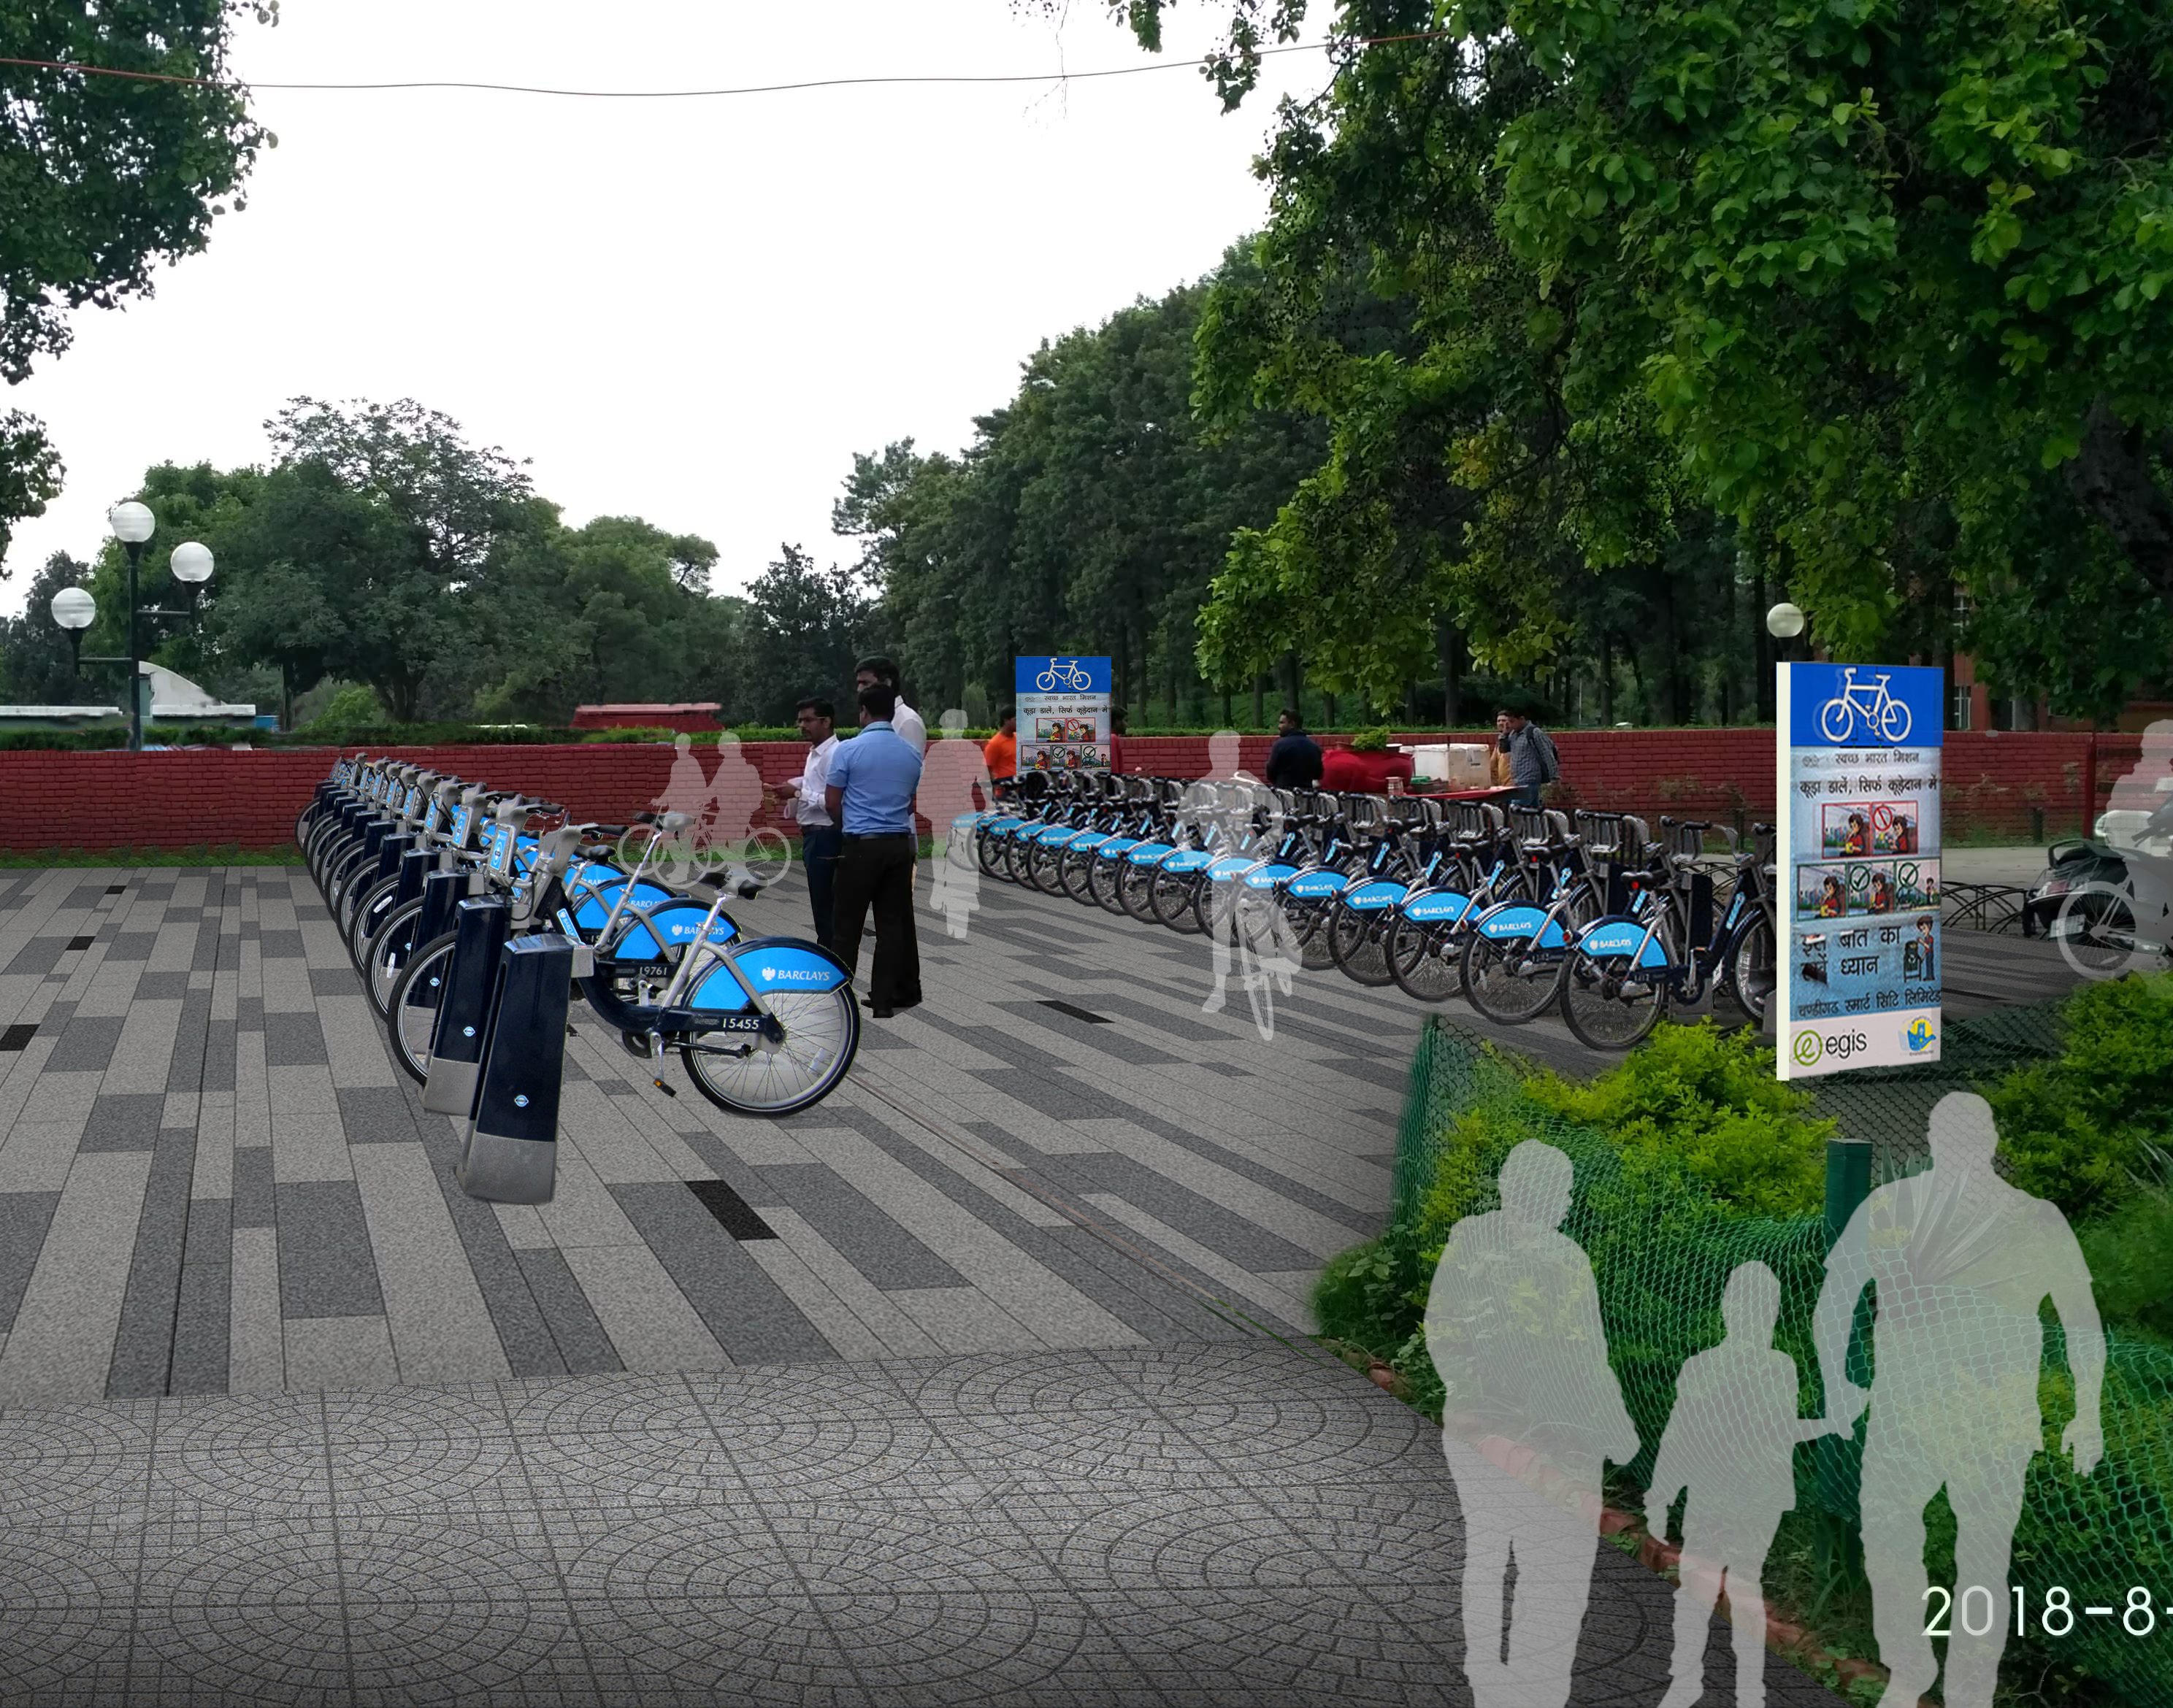
Public Bike Sharing System & Cycle Tracks
Components
Features
Largest PBS -Pan City Coverage Last mile connectivity with 5000 bikes & 617 Docks
No Financial implications-- PPP Mode
Bids Under Evaluation
Expected Date of Work Order: 15/02/2020
Approx 190 Km of Dedicated Cycle Track- Completed.
Intelligent Integrated Docks
Intelligent Command Control Centre
Back lit panels for advertisement & public
information dissemination

Slide 14
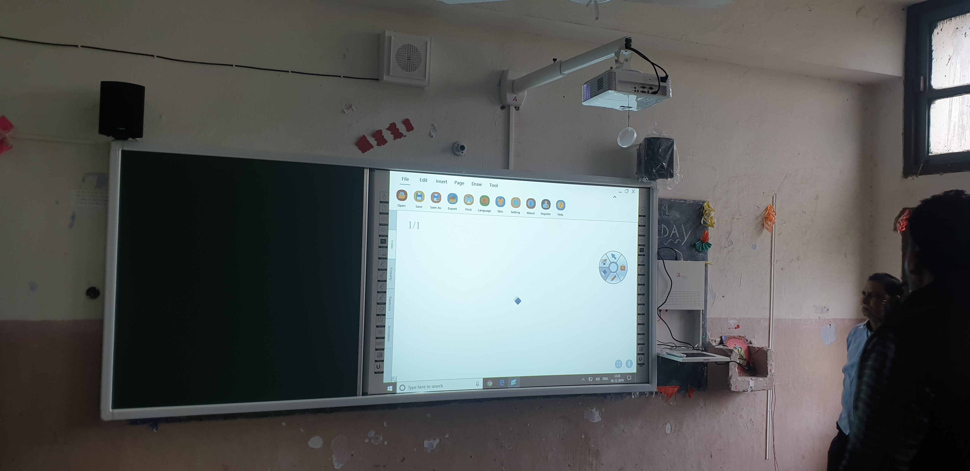
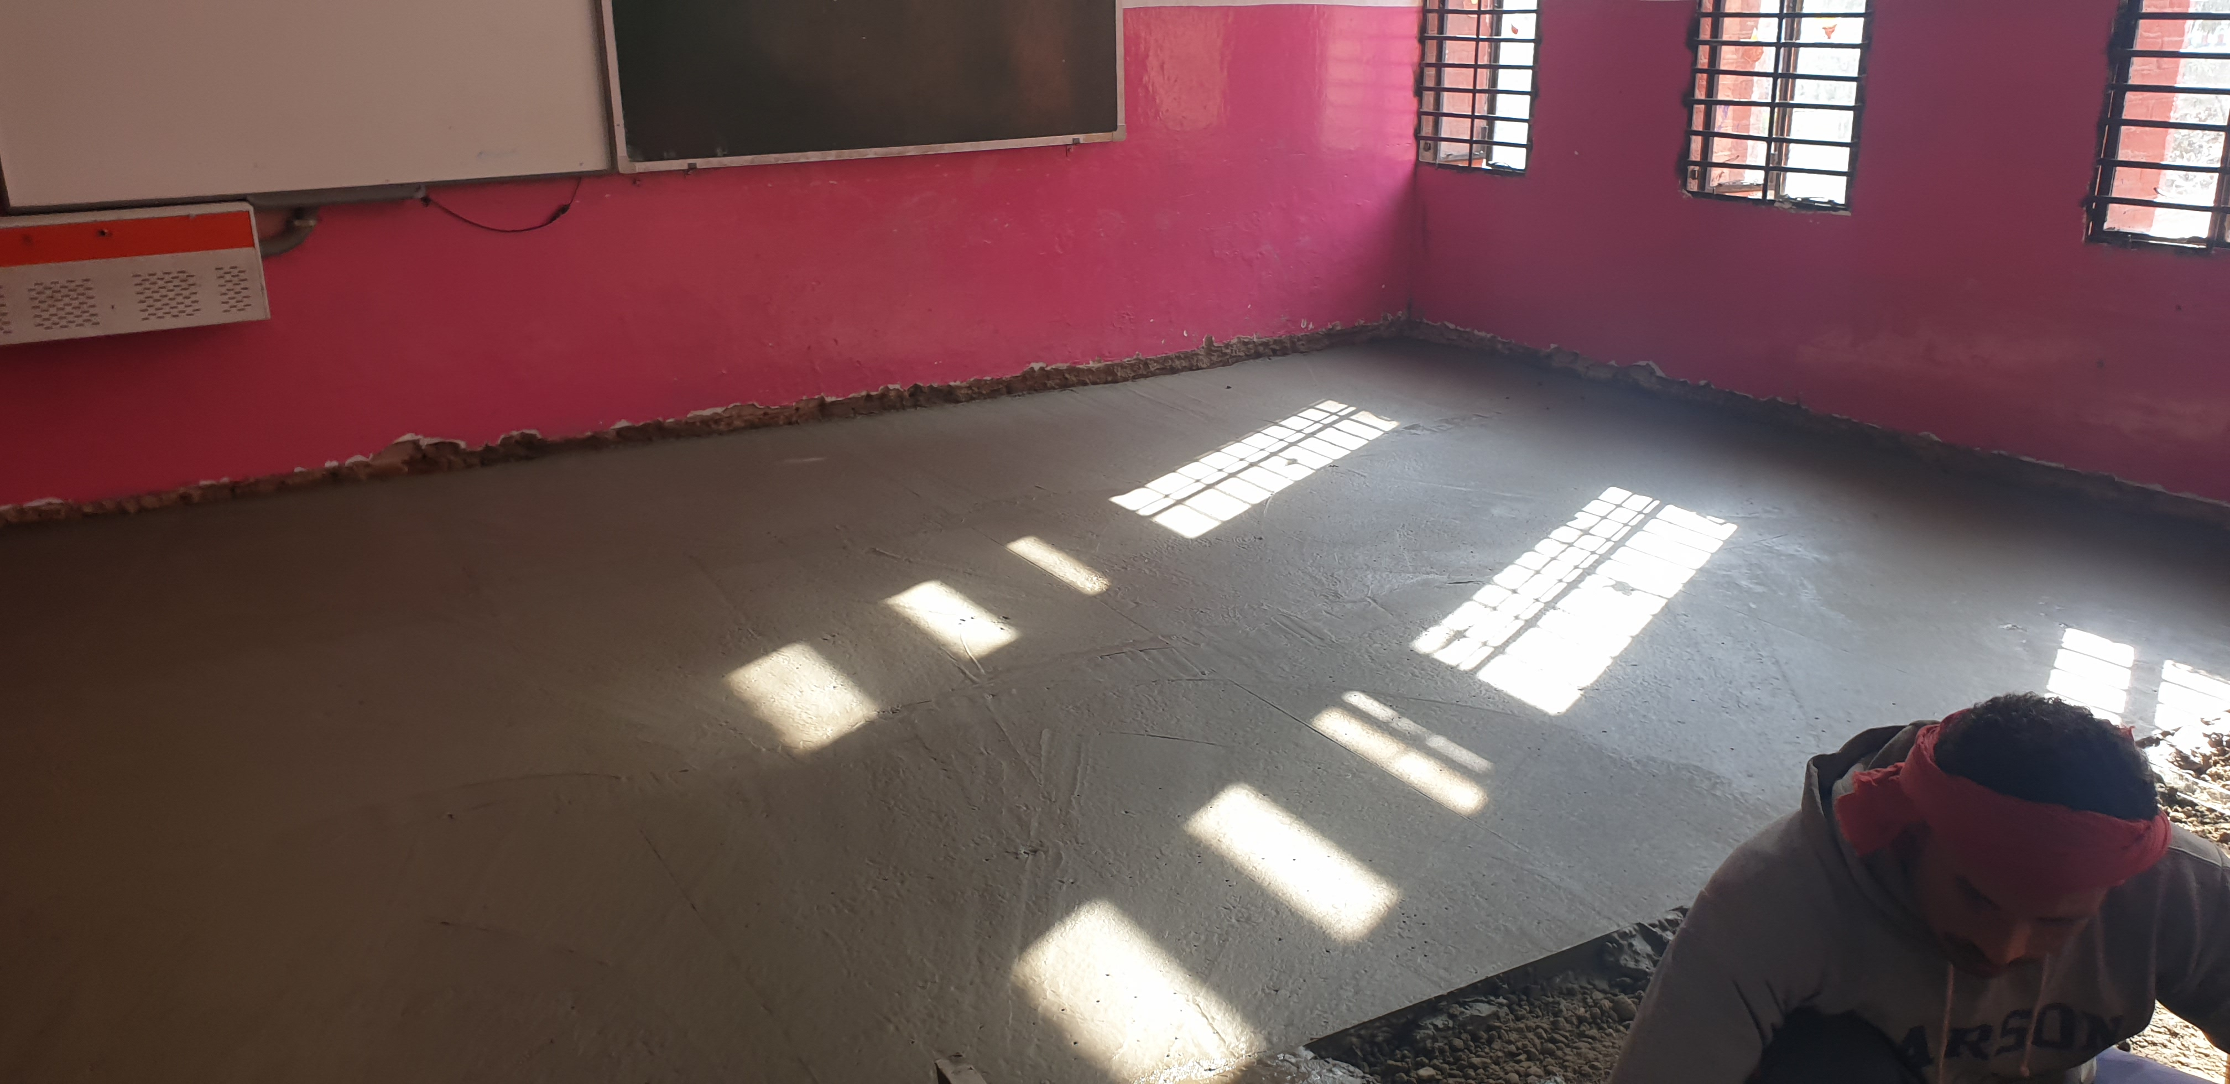
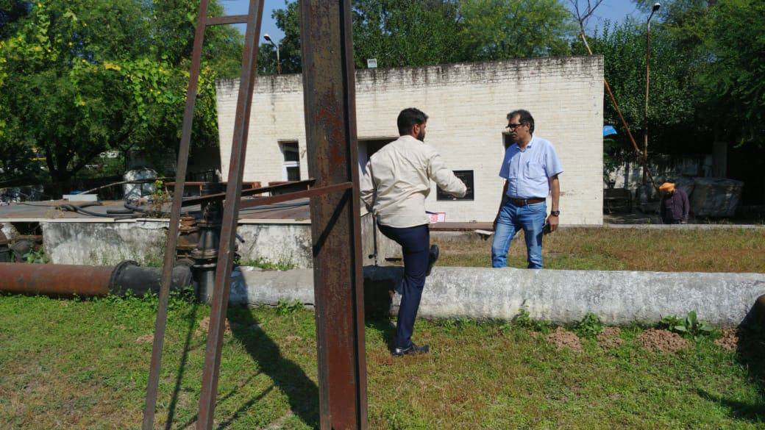
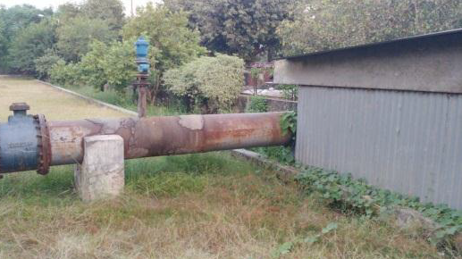
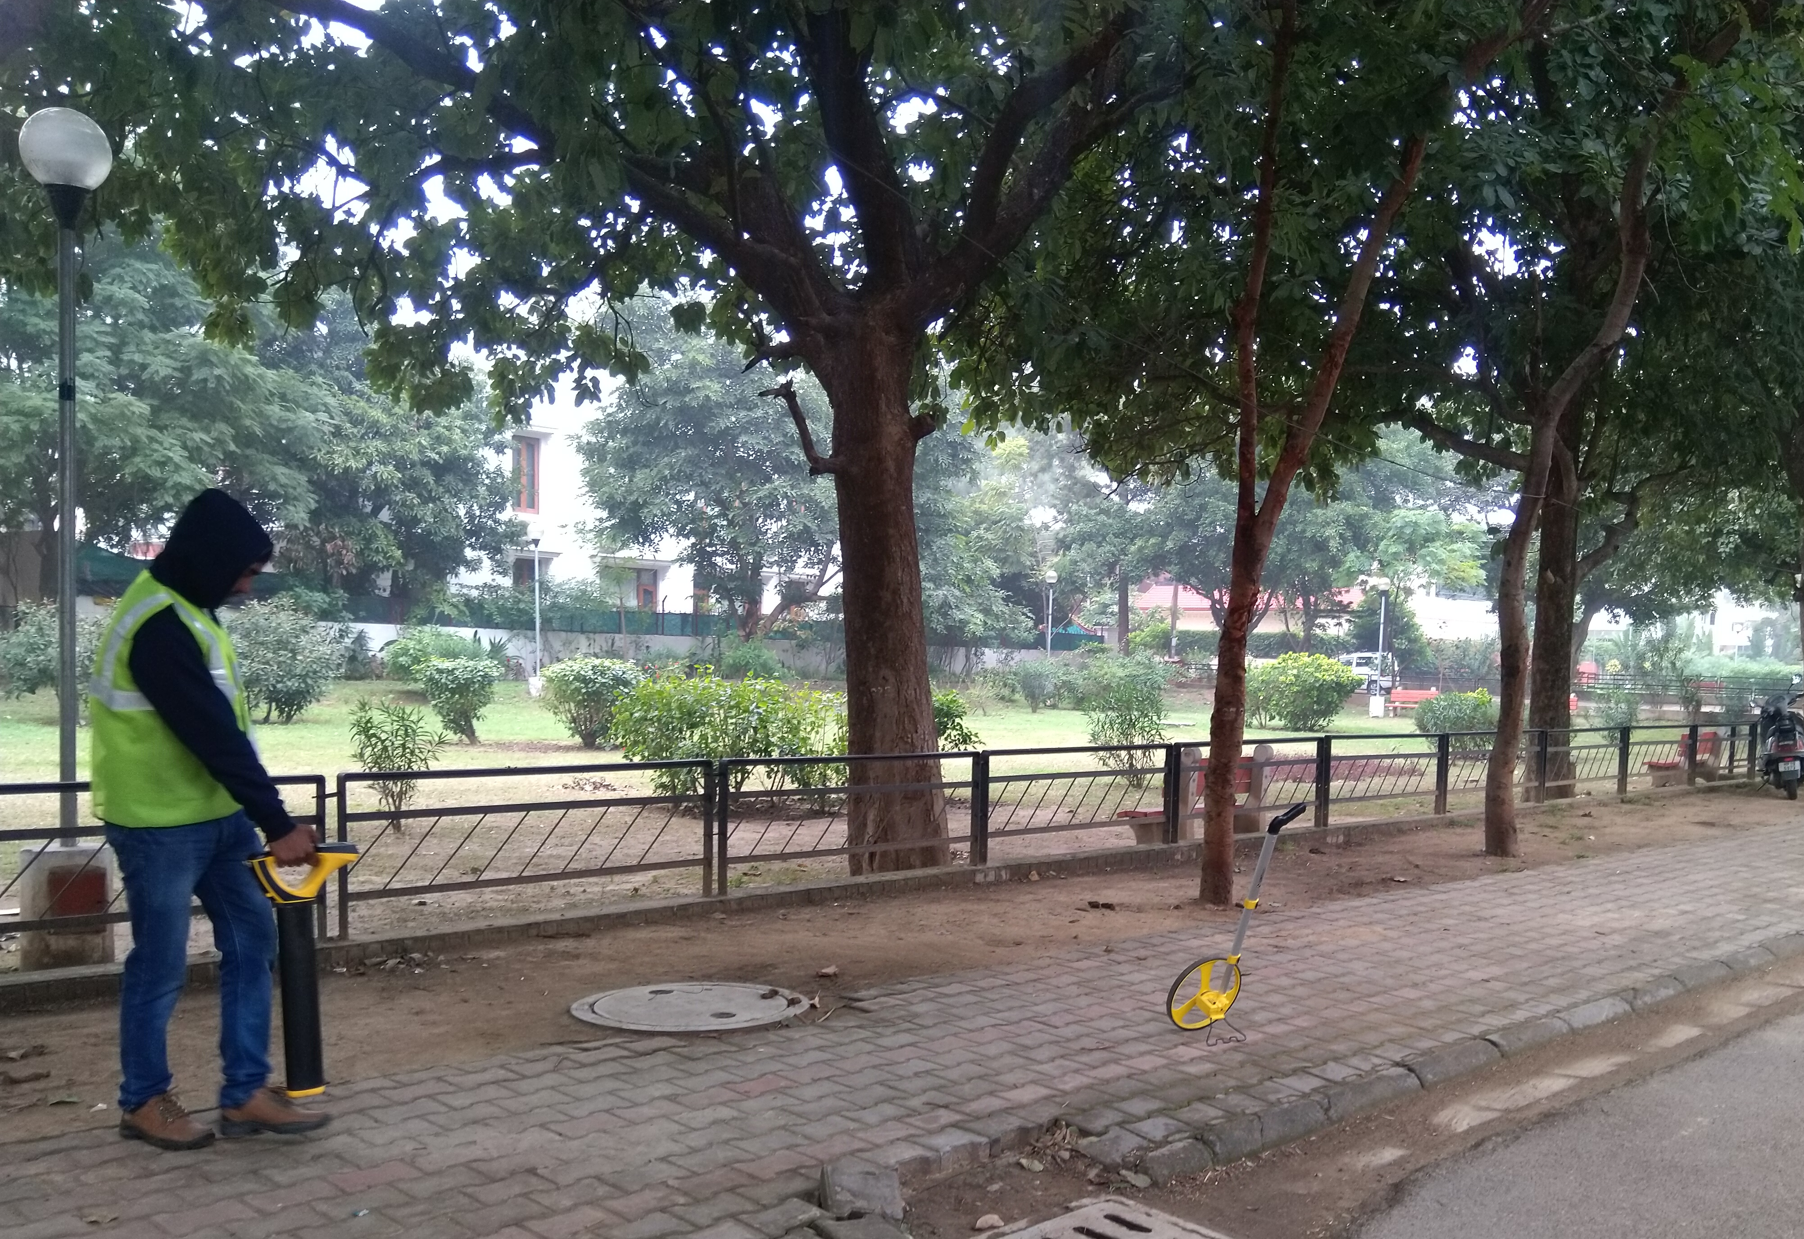
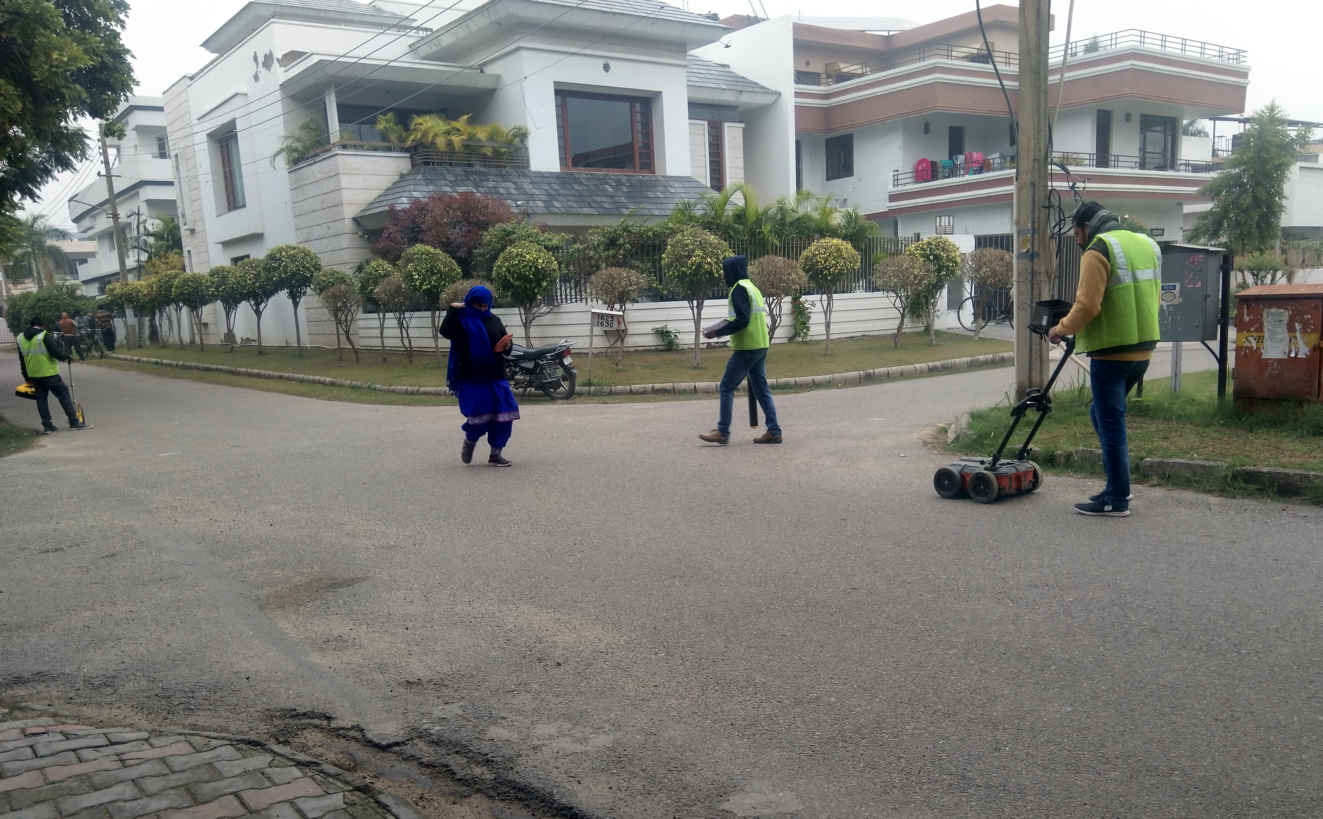
Other Projects
Implementation of Smart School in ABD
Total Cost 4.8 Cr.
Date of Completion of project: 16/04/2020
Basic Infrastructure for Smart Schools
Total Cost 0.5 Cr.
Date of Completion of project: 14/04/2020
SCADA System (Tertiary Water) Work Progress Approval of Equipments under process Project Cost : Rs 4.0 Cr (with 5 year O&M) Completion: 10/10/2020
Underground Utility Mapping Project Cost : Rs 6.0 Cr Work Progress 350 Km of survey completed out of 1550 Km

Slide 15
REQUEST FOR MoHUA
Urban Redevelopment and Retrofit -Sector 43
Rs. 4932 Cr (PPP Project)
Status: Project dropped from SCP as it was in forest land.
City has requested MoHUA to revise the SCP project size in MIS

Slide 16
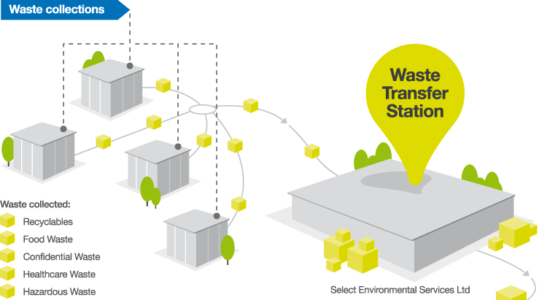
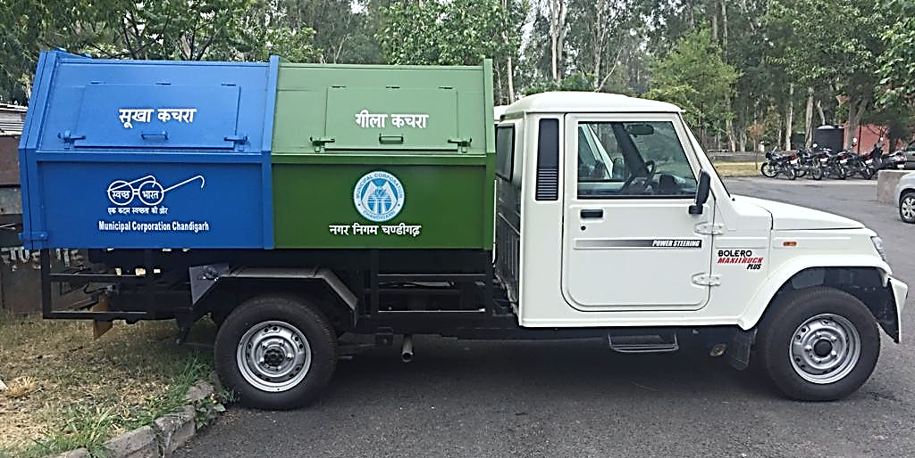
Garbage Transfer Station cum Material Recovery Facility
Total 3 no. MRF-cum GTS proposed
Segregated wet and dry waste processing
Material recovery platform for segregation of reusable materials
Dry waste end product carried to RDF plant
Wet waste end product carried to Compost plant
Stage: Tenders Under Evaluation
MRF cum GTS Station
Purchase of Small Vehicle
Expected Date of award of work: 15/02/2020
Expected Date of completion of work: 15/08/2020
MRF-cum-GTS at 3 locations
SCADA
Purchase of small vehicles

Slide 17
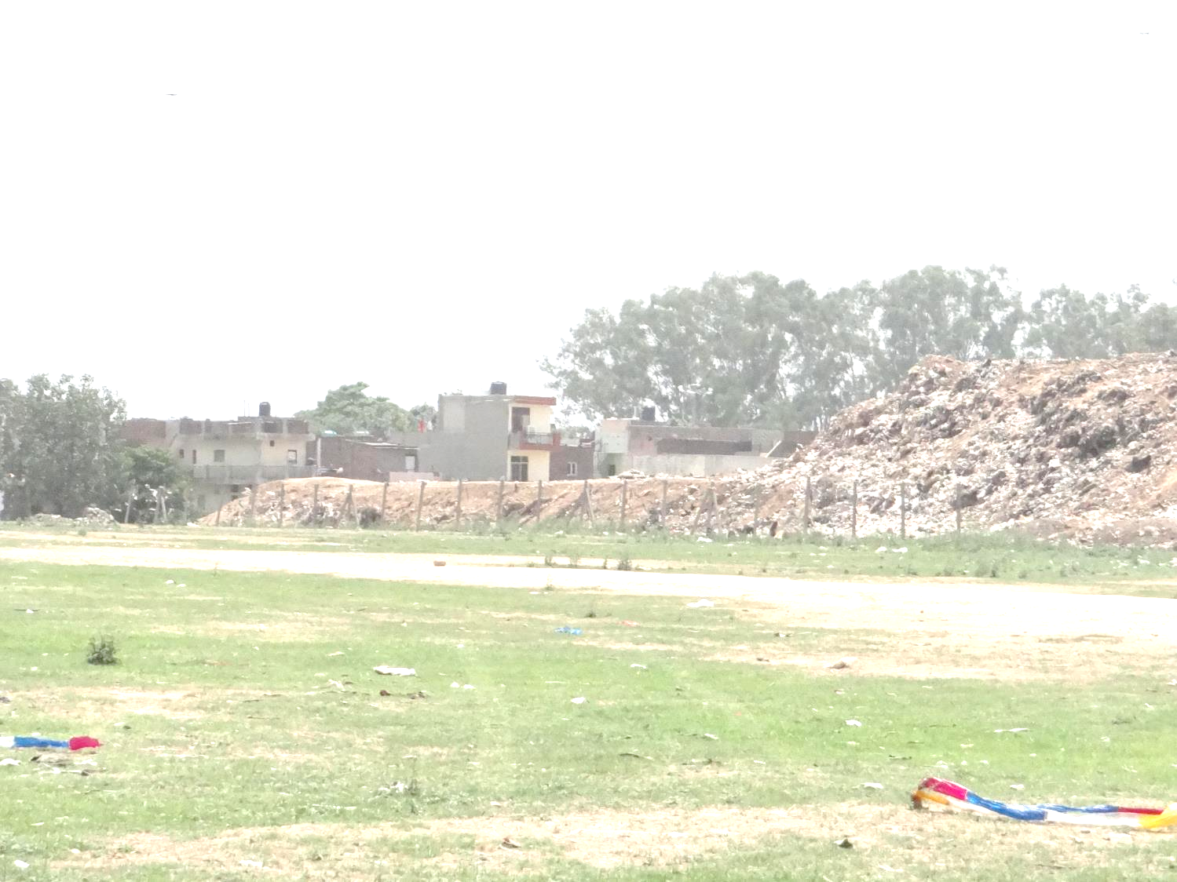
INCINERATOR FOR ANIMAL CARCASS
Impact
Environmental friendly disposal of animal carcasses
Omission of public nuisance due to unhygienic disposal of carcasses
Pollution (land and air)control
Proposed Mode | Design and Built with 5 years AMC
CAPEX & OPEX | Estimated Project Cost:-Rs. 1.8 Cr.
Project Status Expected Work Order Issue :15th Feb 2020

Slide 18
Construction and Management of Sanitary landfill
Particulars | Project Details
Project Location | Pan City
Project Components | Design, Build Operate and transfer of Engineered Sanitary Landfill Facilities for Municipal Solid Waste in Chandigarh are proposed to be implemented with private participation under a Build-Operate-Transfer (BOT) Concession framework for a concession period of 27 yrs. out of which 12 years active operation and 15 years post closure period.
CAPEX & OPEX | Estimated Project Cost:- Rs. 30Crore
Project Status | DPR under Preparation

